Slide 1

Welcome to Abravanel Hall
and your 5th grade concert!

Slide 2
Enjoy today’s concert of
ENCORE!
A Celebration of Black Symphonic Music
with your

Slide 3
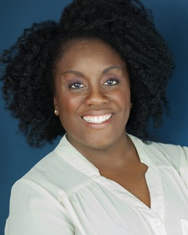
Today’s concert features local jazz singer and actress Dee-Dee Darby-Duffin as our narrator.

Slide 4


The Utah Symphony thanks Plan-B Theatre and the Utah Division of Arts & Museums
for sponsoring our Narrator and Script for this year’s 5th grade concerts.

Slide 5
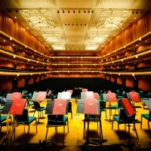
The Utah Symphony has
85 orchestra musicians
1 music director
1 associate conductor
2 librarians

Slide 6
What’s the word for the person who leads the orchestra?
And what’s the name of the stick he or she waves?

Slide 7
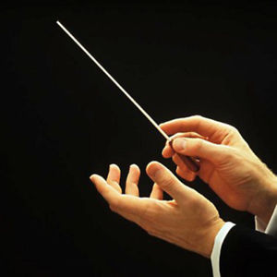
The conductor leads the orchestra
using a baton.

Slide 8
Maestro is a title given to conductors.
It means “master.” It is pronounced
MY - stro

Slide 9
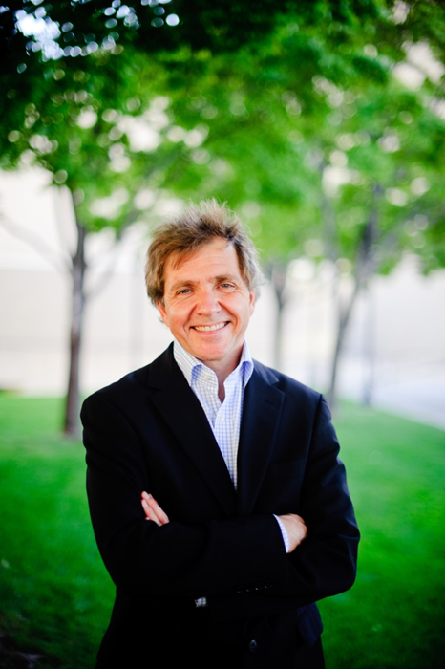
Maestro Thierry Fischer is the Music Director of the Utah Symphony.

Slide 10
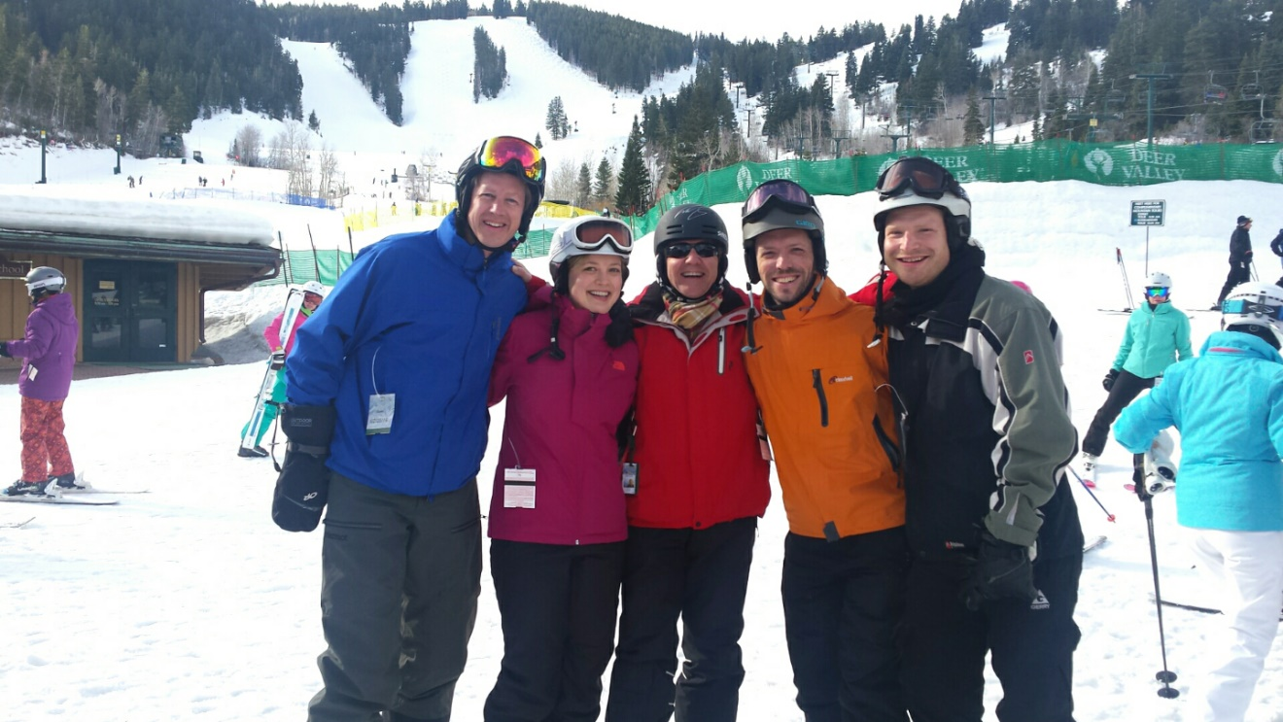
Utah Symphony’s annual
Ski Day with the Maestro
Maestro Thierry Fischer
John Eckstein, cello
Mark Davidson, trombone
Kathryn Eberle, violin
Joel Gibbs, viola

Slide 11
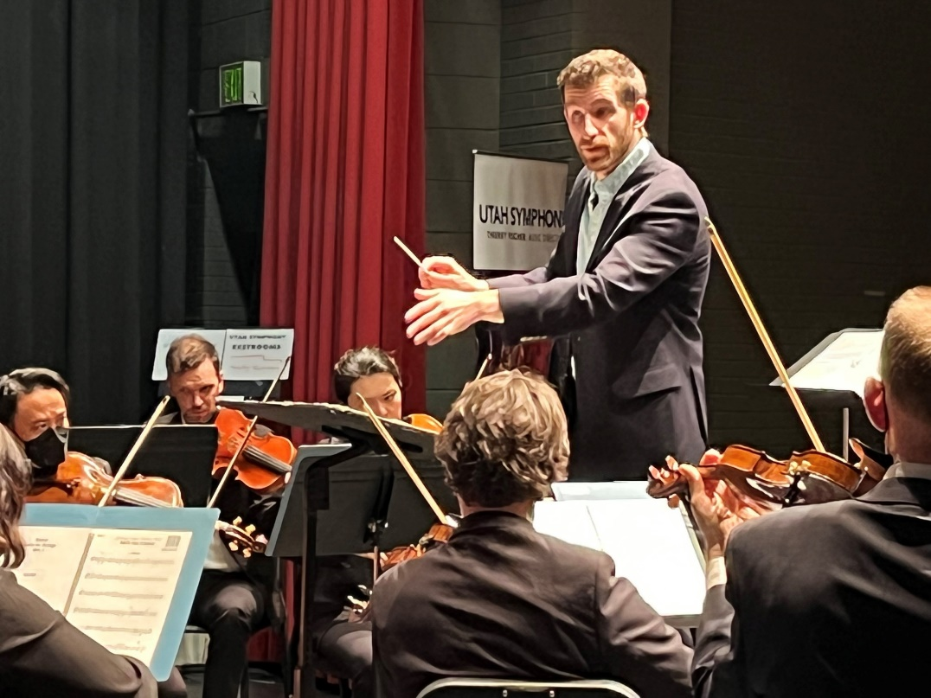
Associate Conductor Ben Manis will be conducting the Utah Symphony in today’s 5th grade concert.

Slide 12
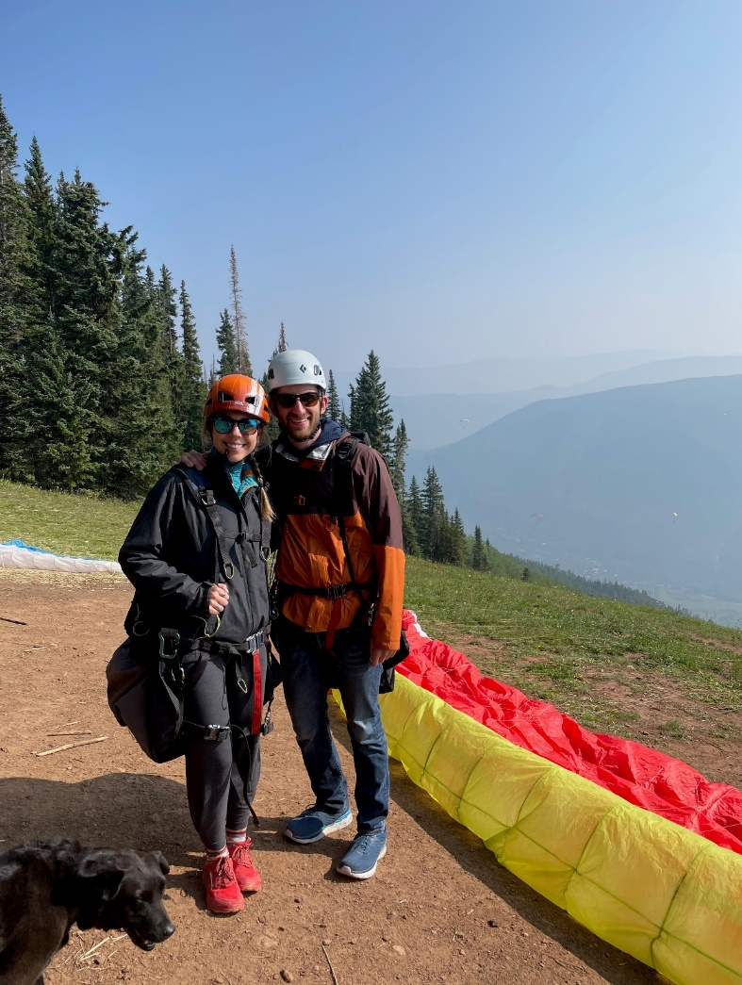
Ben and his fiancé Emily enjoying a paragliding adventure

Slide 13




Thanks to Our Sponsors
Today’s concert was made possible by the financial support of many donors, including generous funding from the Professional Outreach Programs in the Schools (POPS), appropriated by the Utah State Legislature through the Utah State Board of Education, as well as The Elizabeth Brown Dee Fund for Music in the Schools.
THE ELIZABETH BROWN DEE FUND FOR MUSIC IN THE SCHOOLS
The Millerberg
Family Giving Fund
Naoma Tate and
The Family of Hal Tate

Slide 14

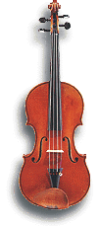
Fun Fact:
Barbara Scowcroft’s
violin was made in
1650 by Nicolo Amati.
That’s before
J.S. Bach was born!

Slide 15


Fun Fact:
Walter Haman’s cello was made by Vincenzo Rugeri in 1697 when J.S. Bach was 12 years old.

Slide 16

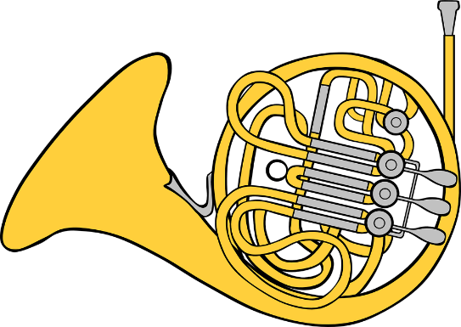
What do you call a cow who plays an instrument?
A MOOsician

Slide 17
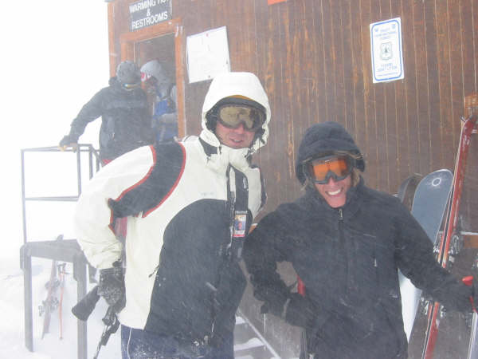
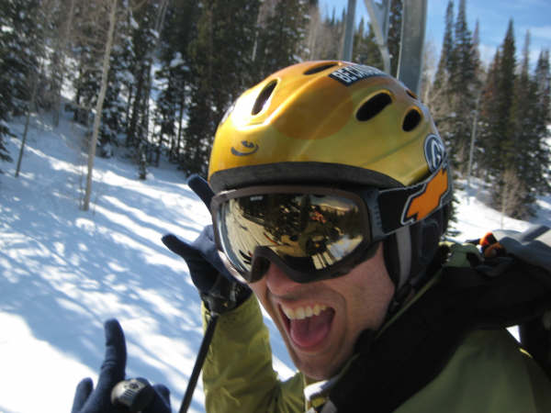
Viola player Brant
Bayless and
violinist David
Porter enjoy a
storm at
Snowbird.

Slide 18
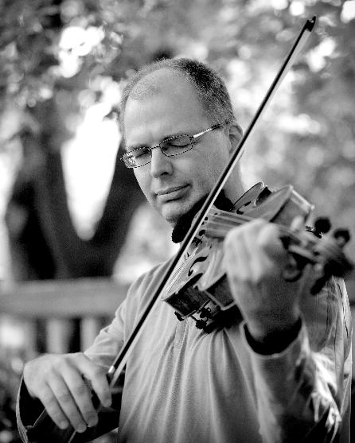
Carl Johansen plays
viola in the orchestra.
One of Carl’s hobbies
is paragliding.

Slide 19

That’s Carl!

Slide 20
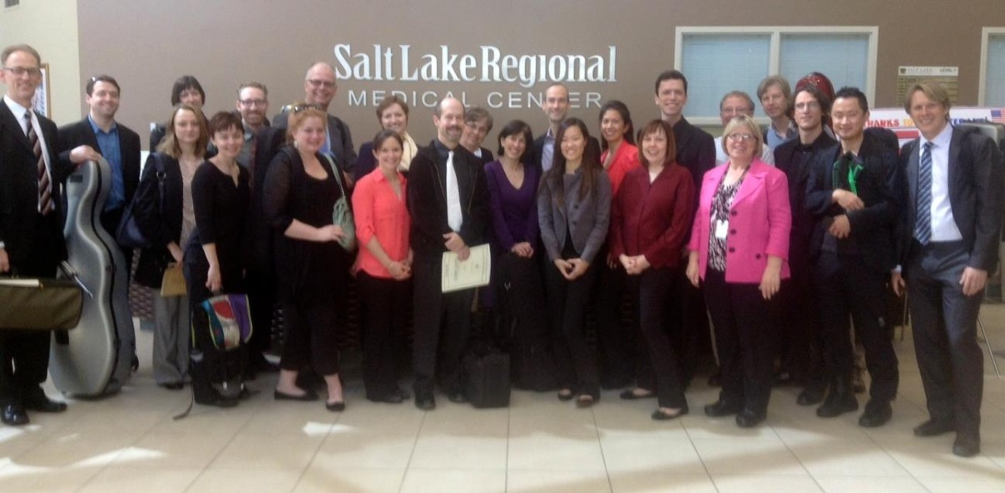
Groups of musicians visit area hospitals to play for patients, families and staff

Slide 21
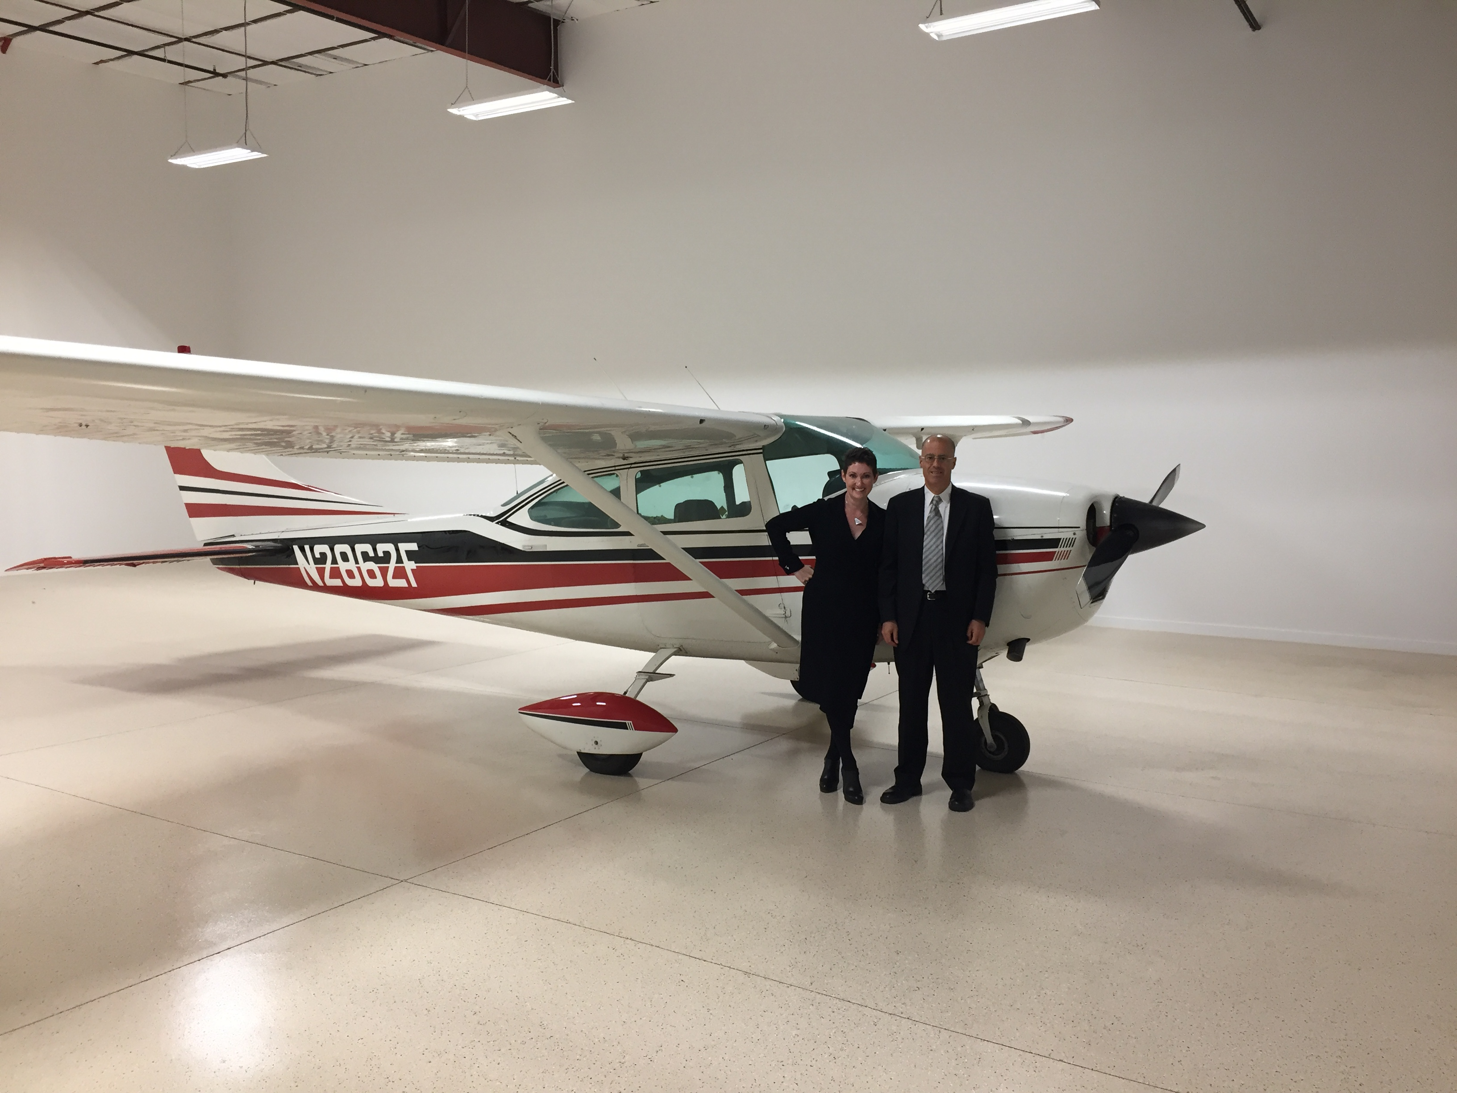
Louise Vickerman is the harpist in the orchestra. She’s also a pilot.
Louise is shown here with husband Pete Margulies, who plays trumpet in the orchestra.

Slide 22
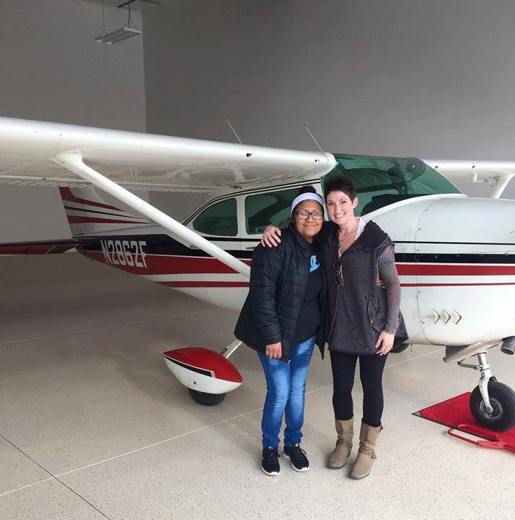
Louise flew a patient from a rural area to a hospital for treatment through the Angel Flight West program.

Slide 23
Can you think of four instruments in the string family?
The smallest plays the highest sounds. As they get larger, the sounds get lower.

Slide 24
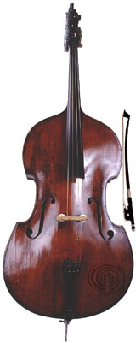
STRINGS
VIOLIN
VIOLA
CELLO
BASS

Slide 25
What instrument does a skeleton play?
A TromBONE!

Slide 26
Enjoy today’s concert of
ENCORE!
A Celebration of Black Symphonic Music
with your

Slide 27
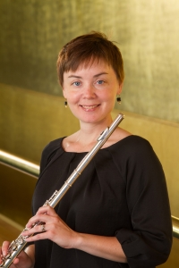
UTAH SYMPHONY FEATURED MUSICIAN
Caitlyn Valovick-Moore plays flute and piccolo in the Utah Symphony.

Slide 28
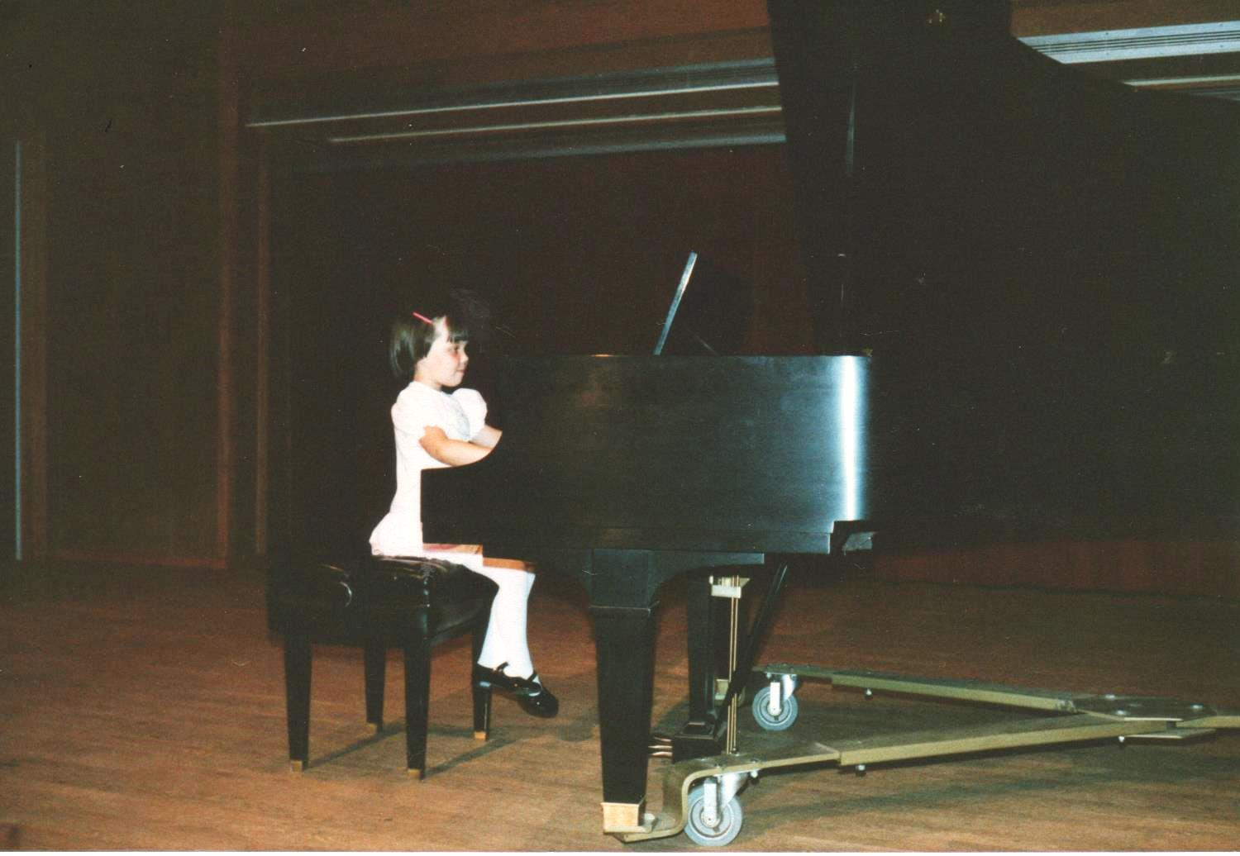
Caitlyn began playing piano when she was 5.
She started playing flute at her school in 6th grade.

Slide 29
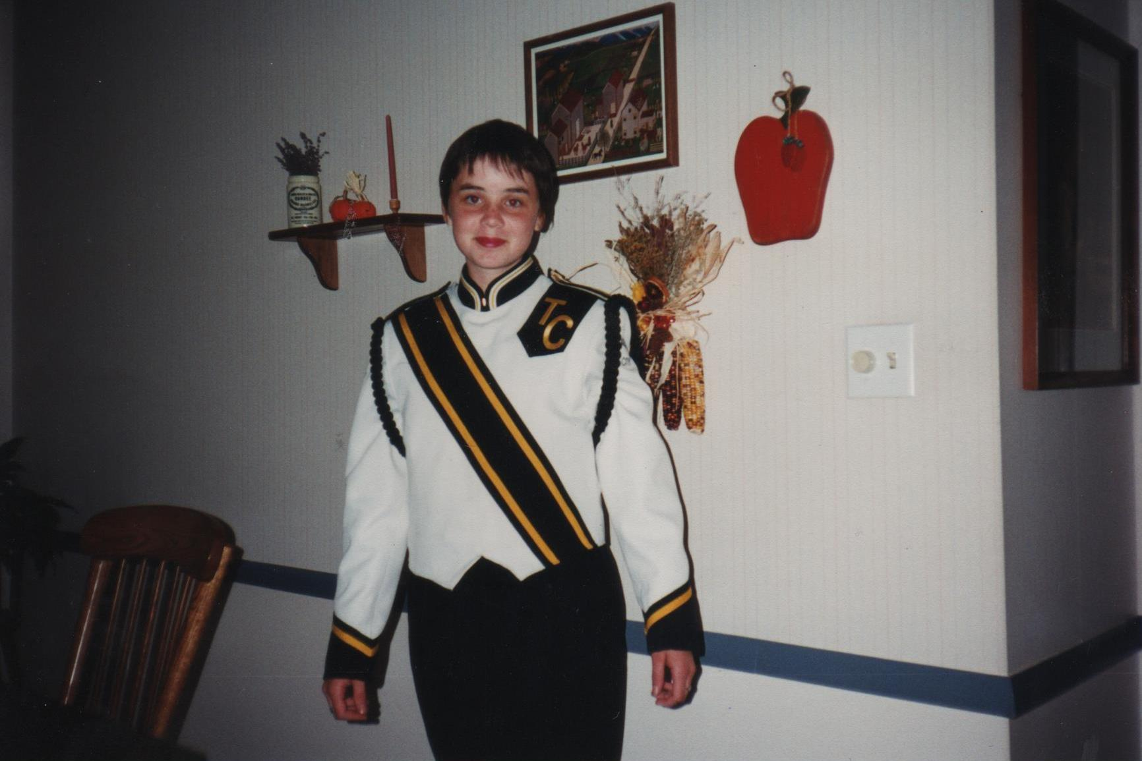
She played in the band and orchestra in junior high and high school.

Slide 30
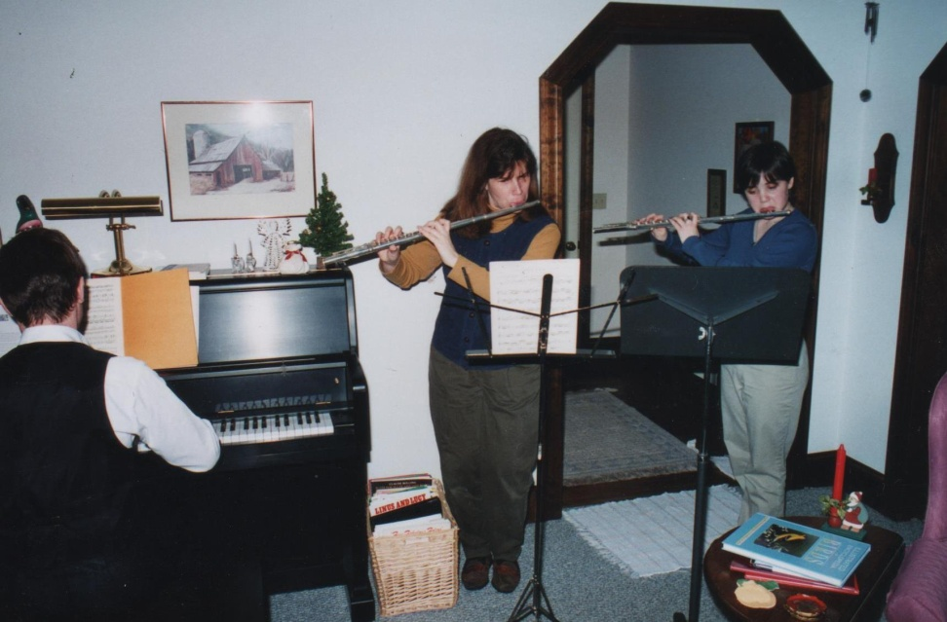
Caitlyn lived away from home at the Interlochen Music Academy for 11th and 12th grade.

Slide 31
Caitlyn has a bachelor’s and master’s degrees
in music and got her job
with the Utah Symphony in 2008.

Slide 32
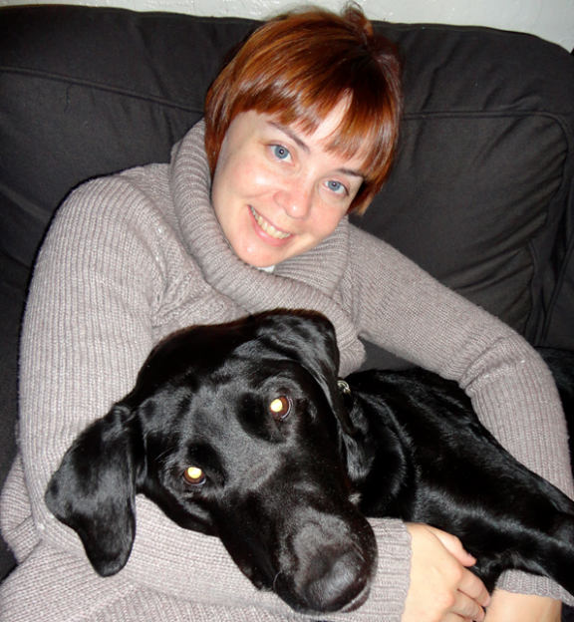
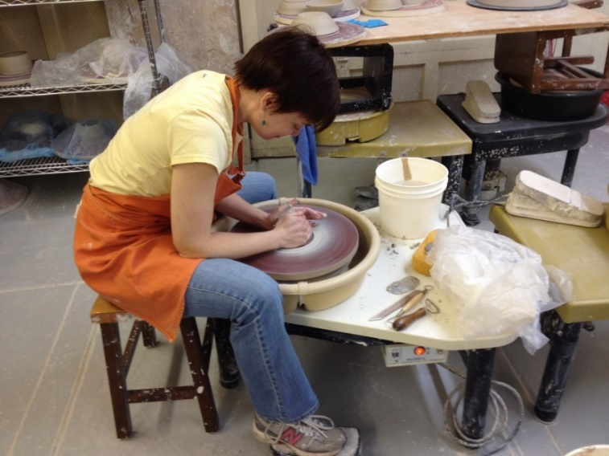
She likes working with ceramics and cuddling with her dog, Samantha.

Slide 33
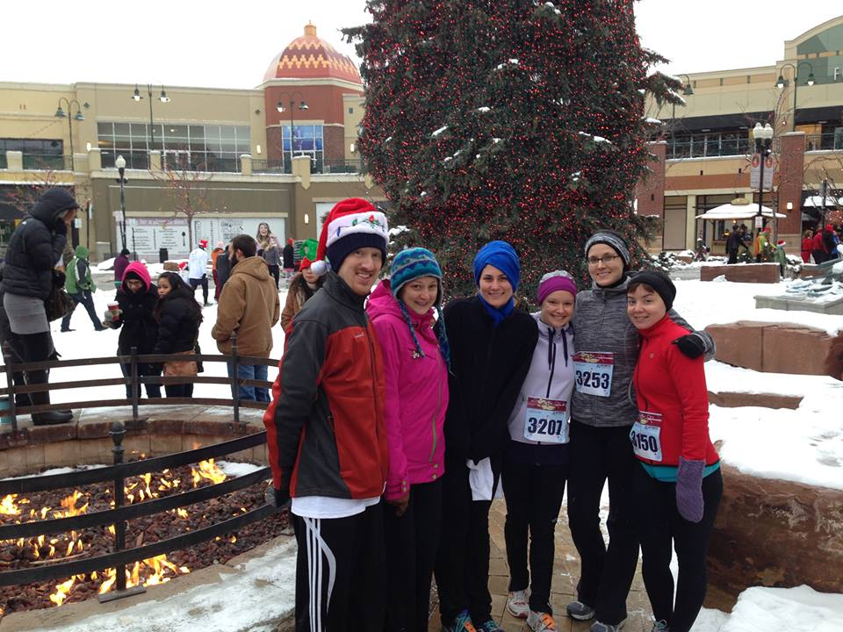
Caitlyn (far right) with fellow musicians before the Jingle Bell run.

Slide 34
Utah Symphony is grateful for generous funding from Professional Outreach Programs
in the Schools
and the Utah State Legislature.

Slide 35
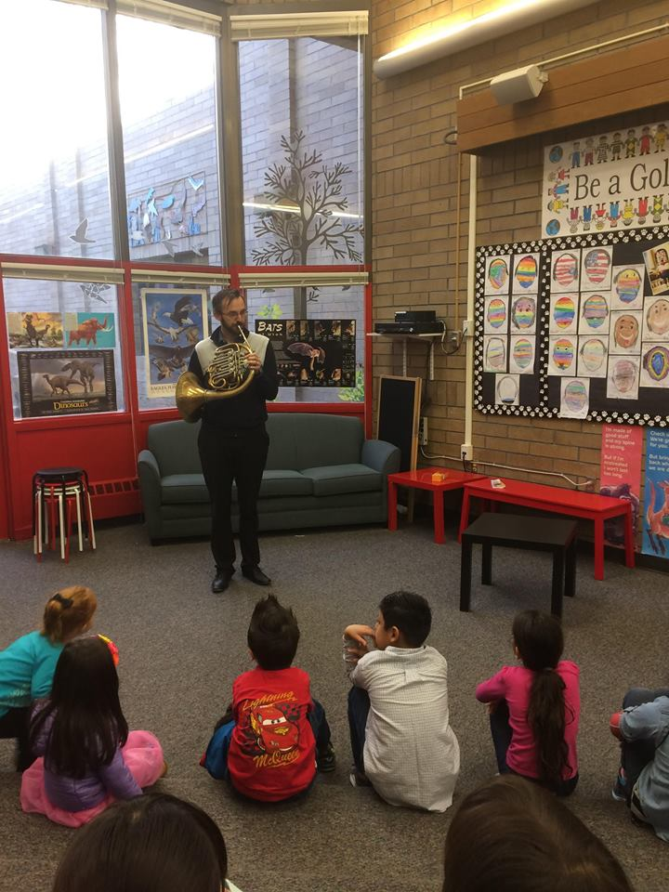
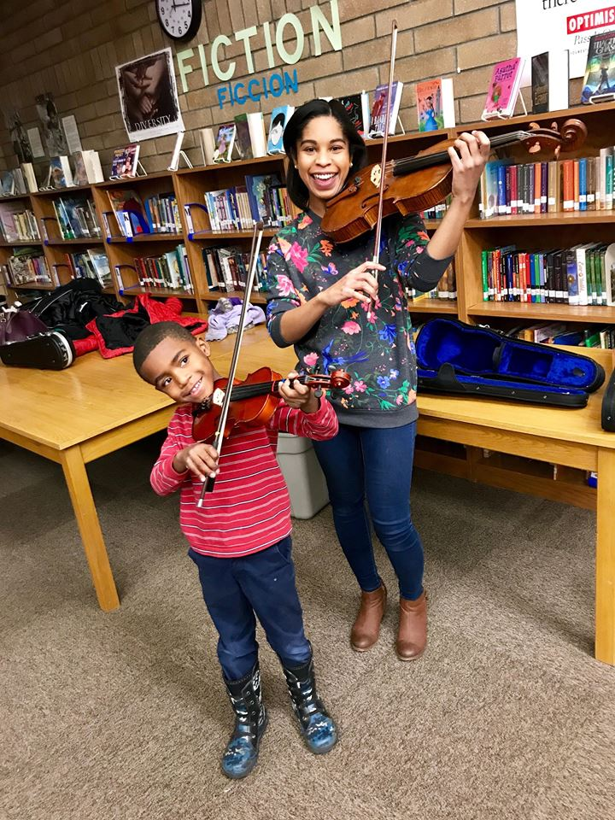
Utah Symphony musicians visit an after-school music program.

Slide 36
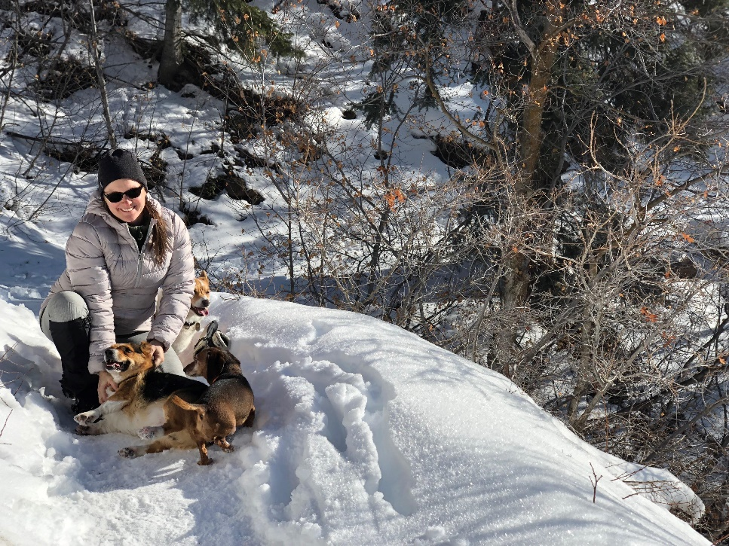
This is clarinet player Erin Svoboda, with her dogs Stout, Diesel, and Haggis on a hike in Millcreek Canyon. Can you spot all three dogs?

Slide 37
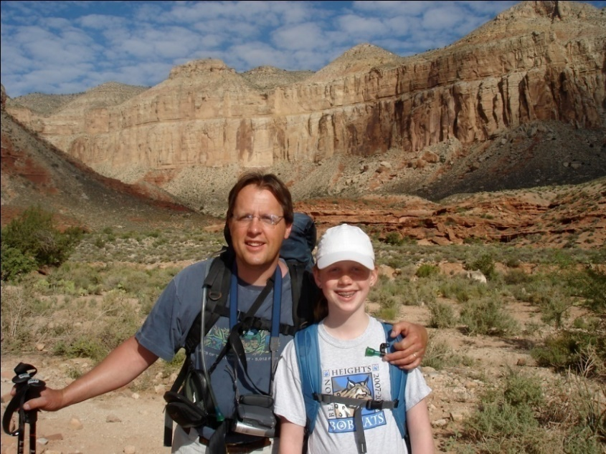
Violinist David Langr
and his daughter
Molly on a hike.
Molly was a harp soloist in
a series of education
concerts with the Utah
Symphony.

Slide 38
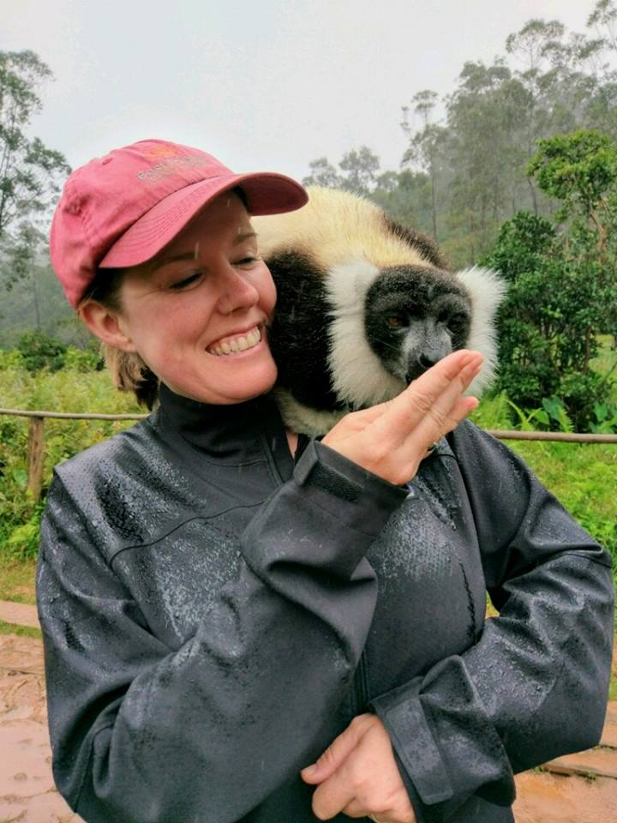
Concertmaster Madeline Adkins met a black and white ruffed lemur on a trip to Madagascar. Pretty cute, huh?

Slide 39
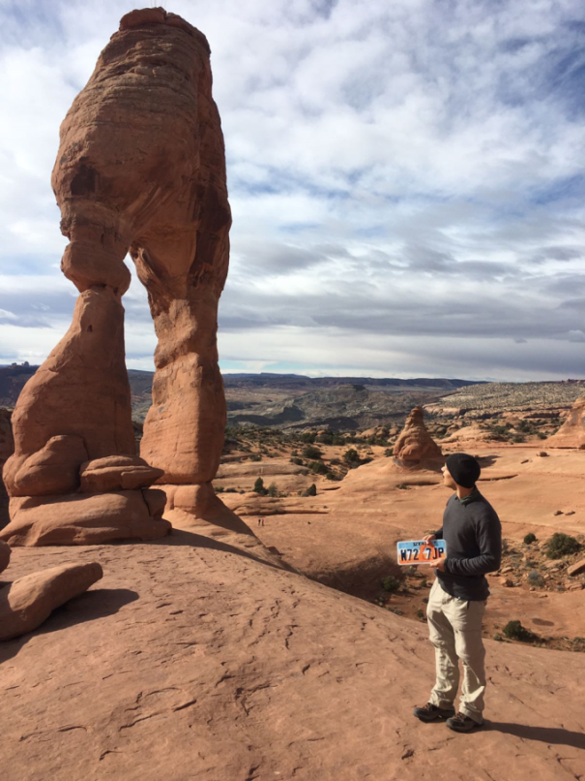
“Wait a minute. Isn’t that the picture on my license plate?”
Cellist Louis-Phillipe Robillard discovers the natural beauty of his new home state.

Slide 40
Which four of these instruments are part of the woodwind family of the orchestra?
Trumpet
Flute
Tambourine
Bassoon
Clarinet
Violin
Oboe

Slide 41
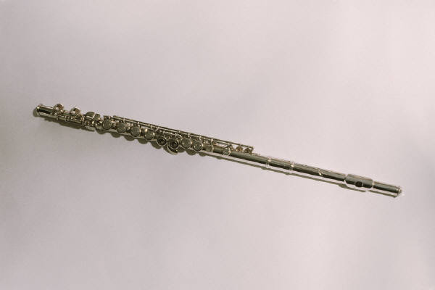

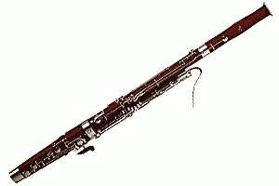
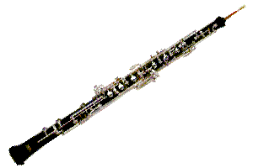
WOODWINDS
b) FLUTE
e) CLARINET
d) BASSOON
g) OBOE

Slide 42

What is a cucumber’s favorite instrument?
The PICKLE-O!

Slide 43
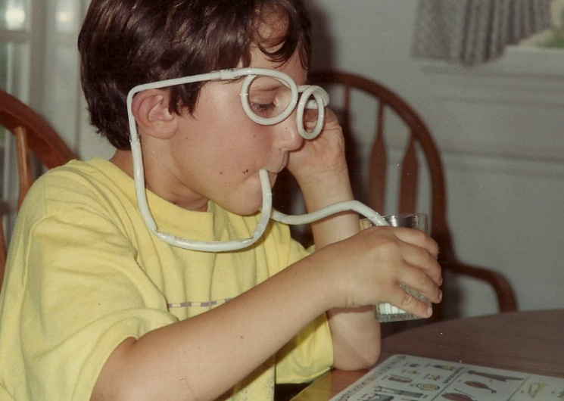
UTAH SYMPHONY FEATURED MUSICIAN
Alex Martin grew up in
Washington D.C. and began
playing the violin in 3rd grade,
partly because his best friend
started lessons.

Slide 44
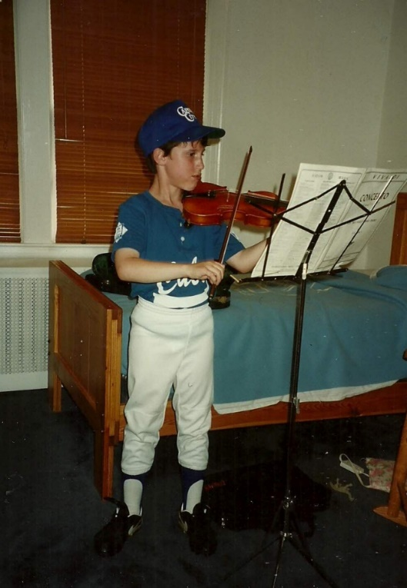
Alex also played
softball and baseball
until he was 13. By
then, he didn’t have
time for both and
found he was better at
the violin.

Slide 45

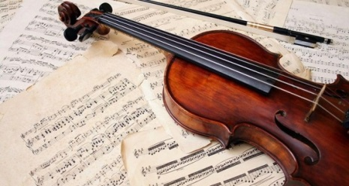
When he was a teenager, he was
interested in both classical and punk
rock music. He believes this gave him a
balanced approach to music.

Slide 46
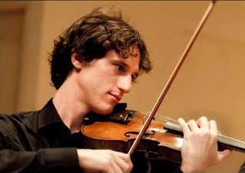
Alex went to Indiana
University, where he
got his bachelor’s and
master’s degrees in music.
He found he had to be
more serious about music there.

Slide 47
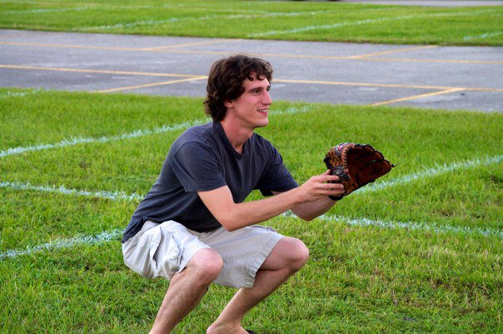
Alex joined our orchestra in 2010. He still likes baseball and
is a Washington Nationals fan.

Slide 48
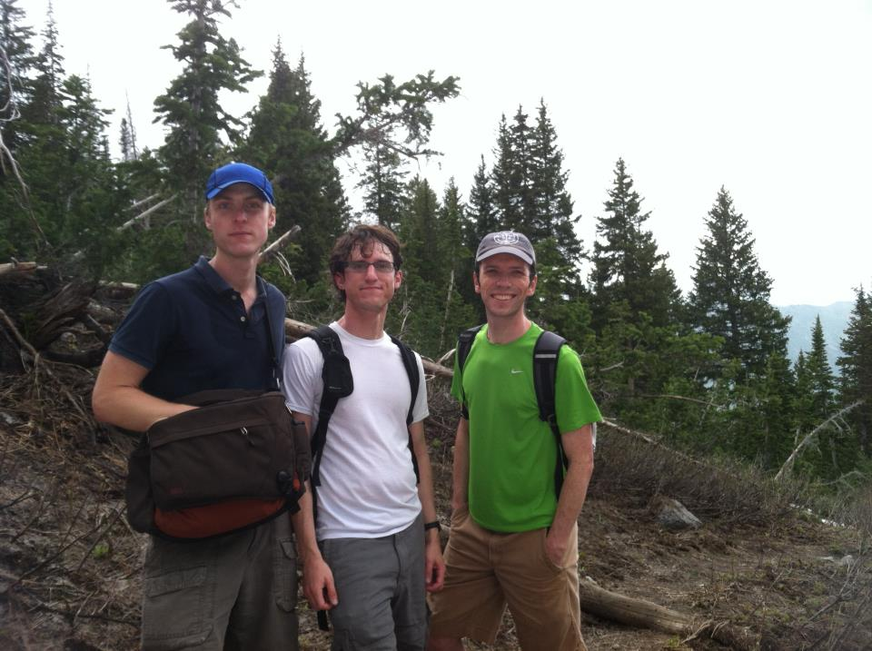
He enjoys skiing and likes the outdoors. Here he’s hiking with fellow musicians
Jens Tenbroek
and Joel Gibbs.

Slide 49
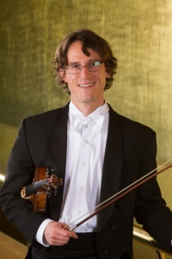
Alex believes choosing music as a career must be your own decision, not one you make to please others.

Slide 50
Thanks to Our Sponsors
Today’s concert was made possible by the financial support of many donors, including generous funding from the Professional Outreach Programs in the Schools (POPS), appropriated by the Utah State Legislature through the Utah State Board of Education, as well as The Elizabeth Brown Dee Fund for Music in the Schools.
THE ELIZABETH BROWN DEE FUND FOR MUSIC IN THE SCHOOLS
The Millerberg
Family Giving Fund
Naoma Tate and
The Family of Hal Tate

Slide 51
Enjoy today’s concert of
ENCORE!
A Celebration of Black Symphonic Music
with your

Slide 52
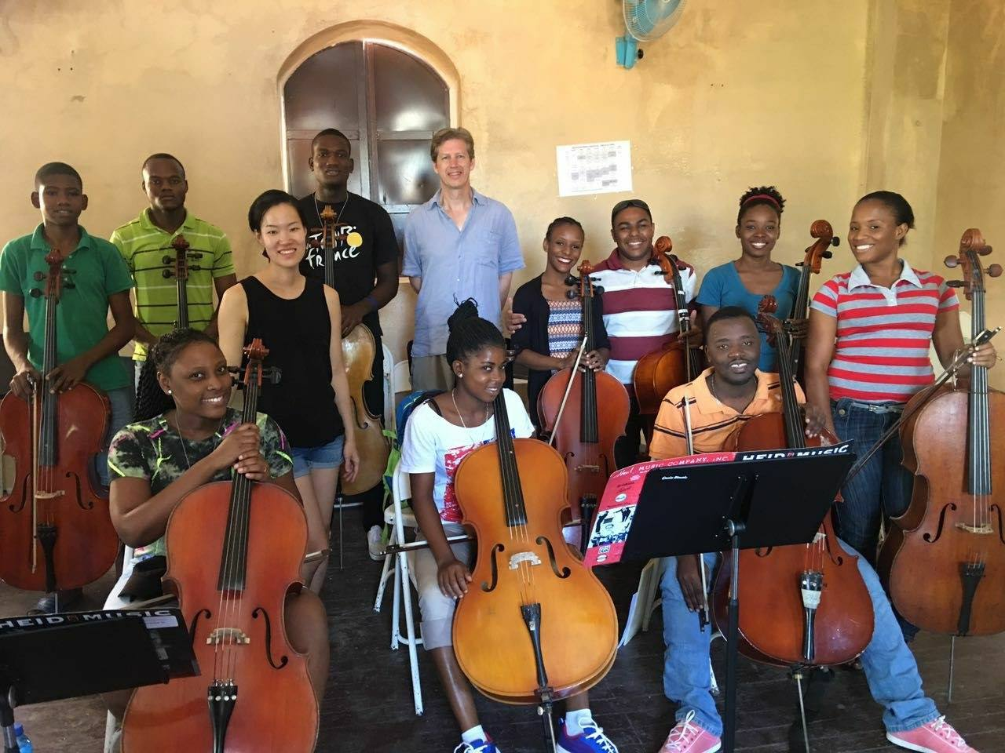
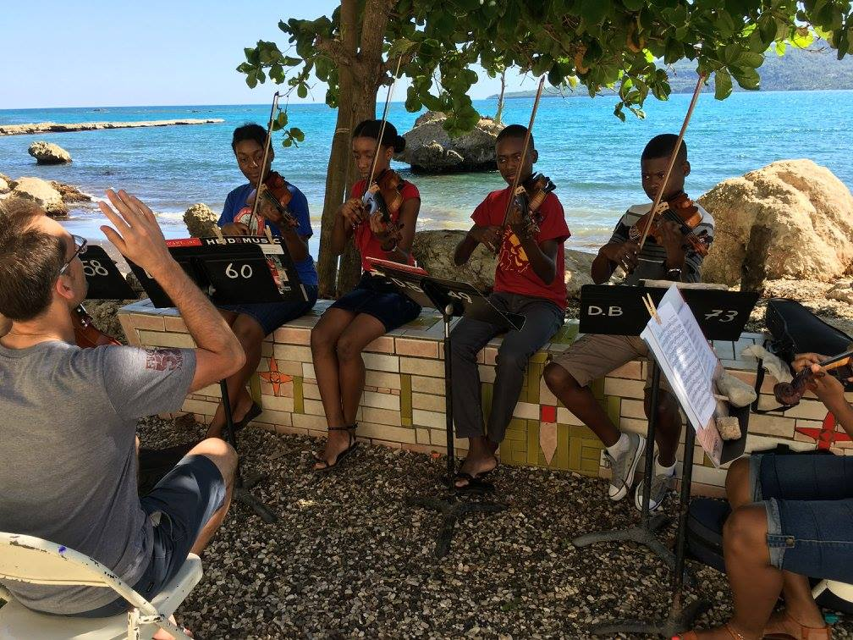
Our musicians frequently travel to Haiti to teach and perform

Slide 53
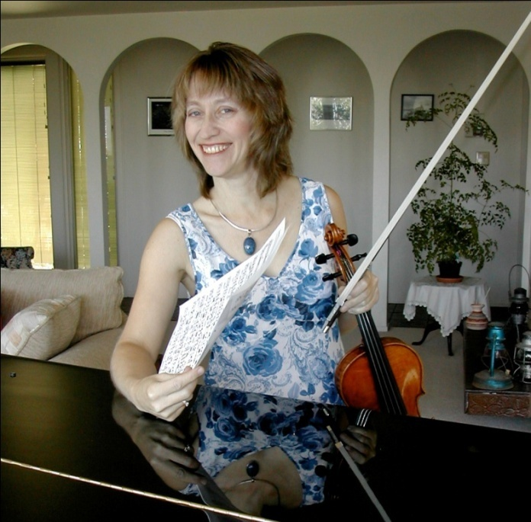
Lynn Rosen is a
violinist in the
orchestra. Her
husband Tad Calcara
plays the clarinet.

Slide 54
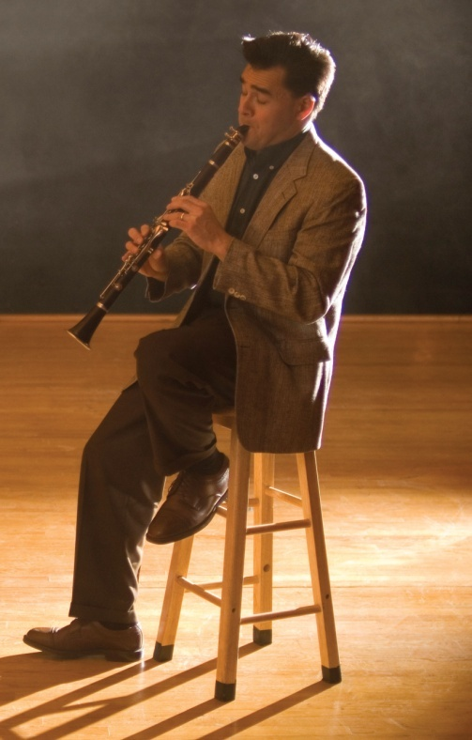
Tad is also
popular for his big
band arrangements.
Notes:
Picture of Tad Calcara playing clarinet

Slide 55
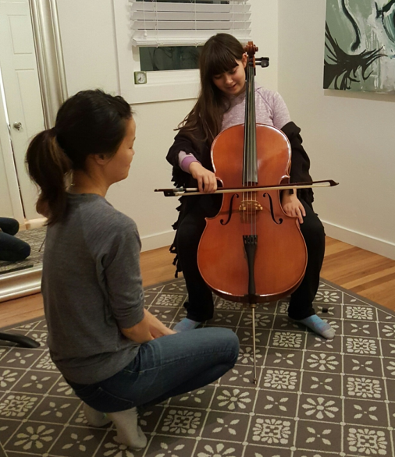
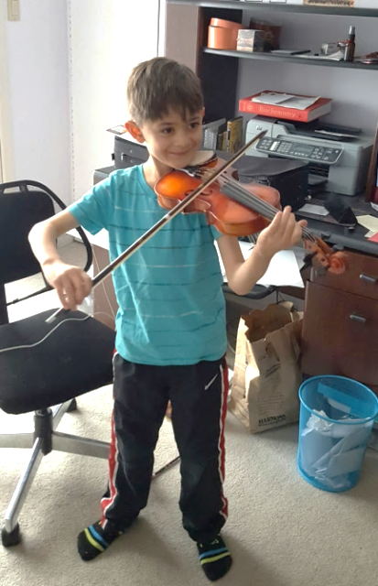
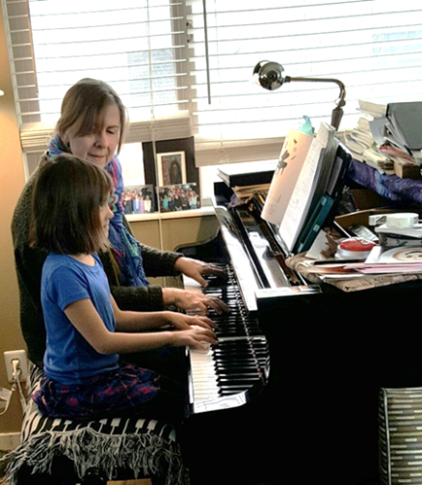
Tad and Lynn’s kids . . . .
have all learned to play musical instruments.

Slide 56
To play a brass instrument, the musicians must buzz their lips to make
the instrument sound.
How many brass instruments
can you think of?

Slide 57
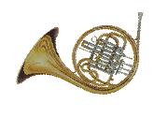
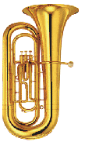
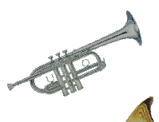

BRASS
FRENCH HORN
TRUMPET
TUBA
TROMBONE

Slide 58
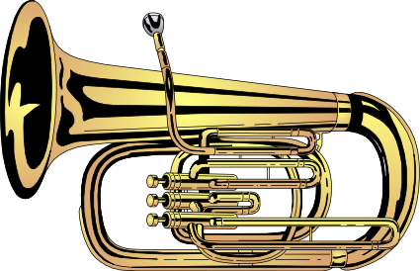
How do you fix a brass instrument?
With a TUBA glue!

Slide 59

School concert
tours in Utah
give orchestra
members the
chance to hike
together.
Yuki MacQueen, violin & Julie Edwards, viola

Slide 60

Jeff Luke, trumpet,
happy on stage at
the Deer Valley
Music Festival.

Slide 61

Jeff Luke off stage.
He seems equally
happy both places!

Slide 62

Mark Davidson plays trombone. Here he is cycling in a race in Colorado. He rode 120 miles! That’s from here in Abravanel Hall to Park City to Provo and back to the Hall.

Slide 63

Bike racks backstage
at Abravanel Hall help
musicians ride to
work.

Slide 64

Utah Symphony musicians play the Star Spangled Banner at a Utah Jazz game.

Slide 65
Percussion instruments must be struck or shaken to be played.
Some of the percussion instruments you might hear include . . .

Slide 66





PERCUSSION
TRIANGLE
Bass Drum
CYMBALS
TIMPANI
TAMBOURINE

Slide 67
What is a mountain’s favorite kind of music?
ROCK music !

Slide 68
Thanks to Our Sponsors
Today’s concert was made possible by the financial support of many donors, including generous funding from the Professional Outreach Programs in the Schools (POPS), appropriated by the Utah State Legislature through the Utah State Board of Education, as well as The Elizabeth Brown Dee Fund for Music in the Schools.
THE ELIZABETH BROWN DEE FUND FOR MUSIC IN THE SCHOOLS
The Millerberg
Family Giving Fund
Naoma Tate and
The Family of Hal Tate

Slide 69

Utah Symphony Featured Musician
Violinist Karen Wyatt began lessons in a public school program when she was 5 years old.

Slide 70

Her dad was taking piano
lessons, so when she was in
the third grade she decide
she wanted to learn that
instrument, too.

Slide 71

Karen and her older sister
played together often
when they were growing up.
Karen is on the left.

Slide 72

Here’s Karen arriving at a New
York City recording studio to
make an audition tape for
college.
She studied violin at Indiana
University.

Slide 73

Karen met her husband Mike Pape when they were both on tour with the Pittsburgh Symphony.
Mike plays percussion in the Utah Symphony.

Slide 74

Their Salt Lake house came with a chicken coop. Seemed like a good idea to get some chickens!
That’s Brandi, Mandi and Candi.

Slide 75
Karen believes
that music is a great creative tool
to help all of us express our emotions.

Slide 76

Cellist Walter Haman
volunteers at the animal
shelter and Best Friends
Animal Sanctuary.

Slide 77

Utah Symphony musicians donate to the Utah Food Bank.

Slide 78

Our flute section with former Governor Herbert on the Utah Symphony’s Mighty 5 Tour of the National Parks.
Caitlyn Valovick Moore
Mercedes Smith
Lisa Byrnes

Slide 79
A few instruments found in our modern orchestra don’t fit well into any of the other families mentioned.
What haven’t we mentioned yet?

Slide 80



OTHER INSTRUMENTS
CELESTE
PIANO
HARP

Slide 81



What kind of music frightens balloons?
POP Music!

Slide 82
Utah Symphony is grateful for generous funding from Professional Outreach Programs
in the Schools
and the Utah State Legislature.

Slide 83

UTAH SYMPHONY FEATURED MUSICIAN
Eric Hopkins plays percussion in the Utah Symphony.

Slide 84

Eric started percussion
lessons
“by accident.”

Slide 85

In 8th grade, he and a friend needed to change their class schedules. Asked what class they wanted to take instead, they said “Okay, we’ll be in band.”

Slide 86

He continued playing in band through high school.
Eric

Slide 87

At Florida State University he started out as a music education major.

Slide 88

Eric was working on his Master’s Degree at the Manhattan School of Music when he got this job in our orchestra.

Slide 89

Eric enjoys all the natural beauty to be explored in Utah. Pictured here with three orchestra friends, Eric is on the right.

