Slide 1
UTAH SYMPHONY
Utah Symphony 5th Grade Concerts
Pre-Concert Information

Slide 2
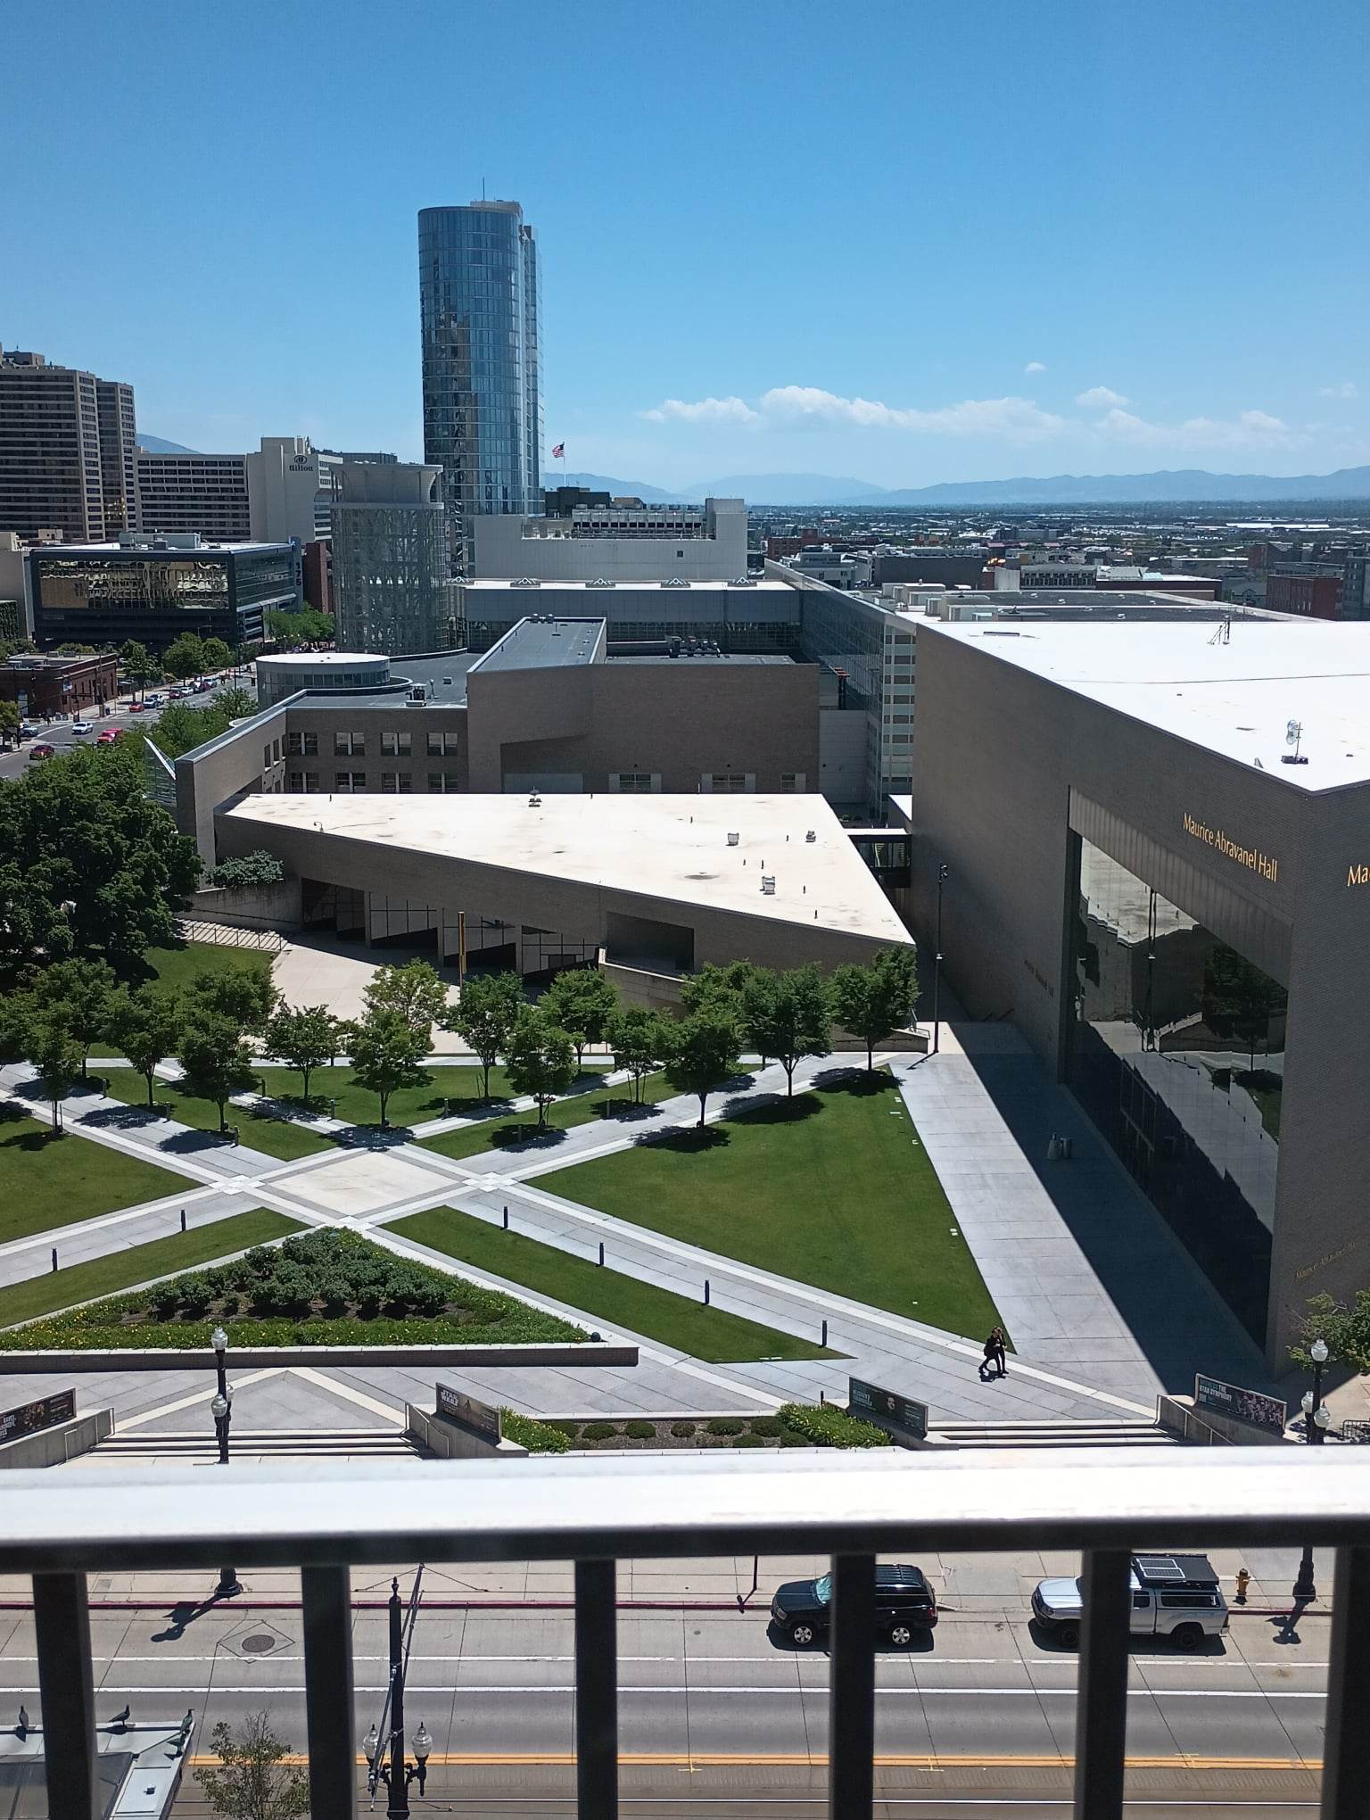
Before the Concert
The concert will be held at Maurice Abravanel Hall in downtown Salt Lake City.
Utah Symphony performs concerts in this hall almost every weekend from September to May.
The building is named after Maurice Abravanel, who conducted the Utah Symphony for over 30 years.

Slide 3
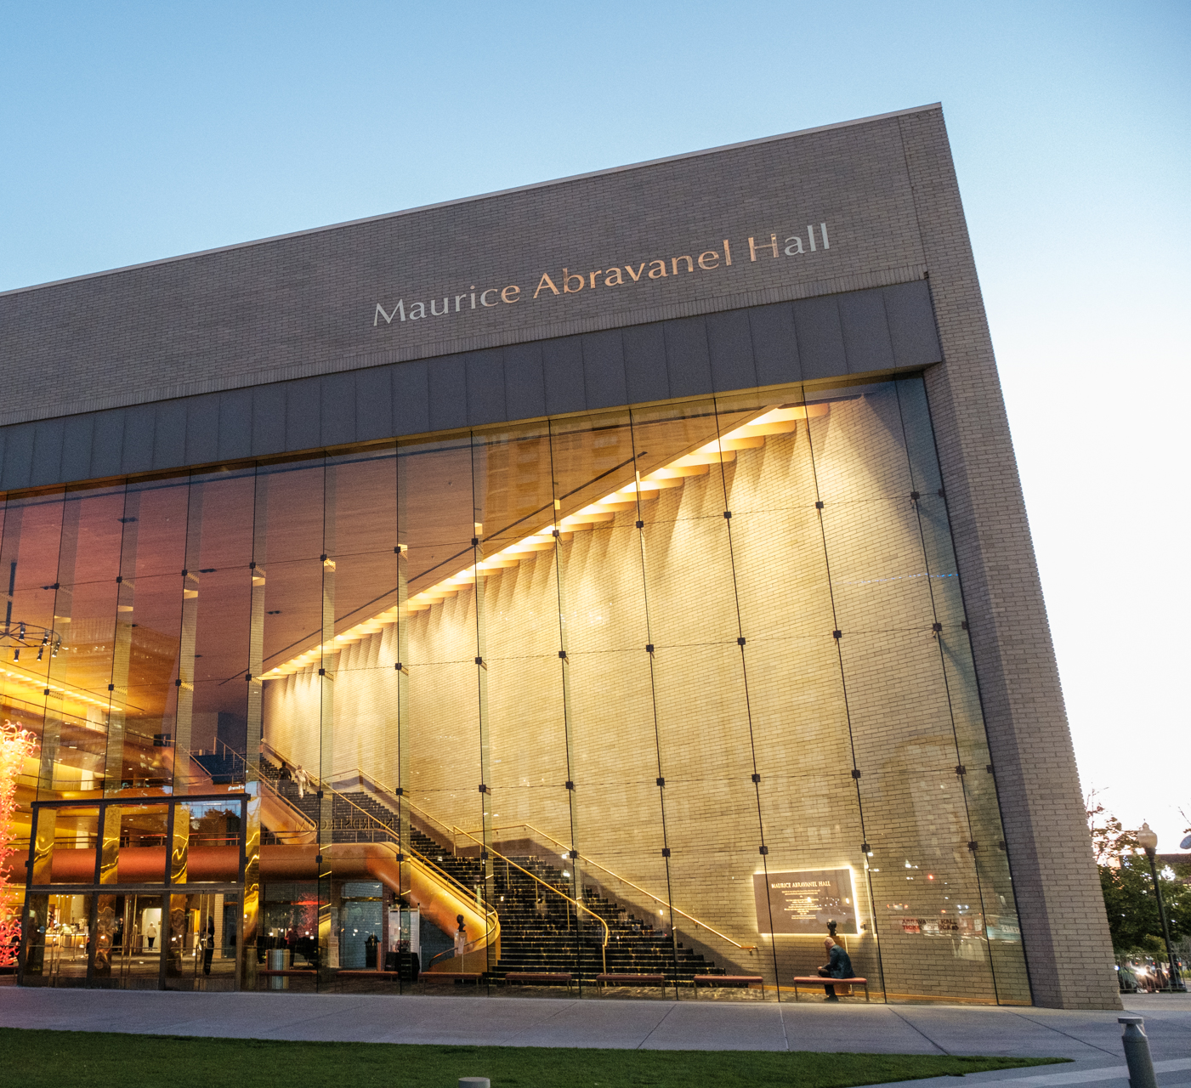
Before the Concert
You might have to walk for a few minutes to get from the bus to the concert hall. Make sure to dress warmly!
You will enter through the glass doors on the east side of the building.

Slide 4
Before the Concert
In the Lobby
You will see a 27 foot tall glass sculpture named “The Olympic Tower,” created by the artist Dale Chihuly.
It is made of 1,276 pieces of blown glass, and it can be taken apart for cleaning.

Slide 5
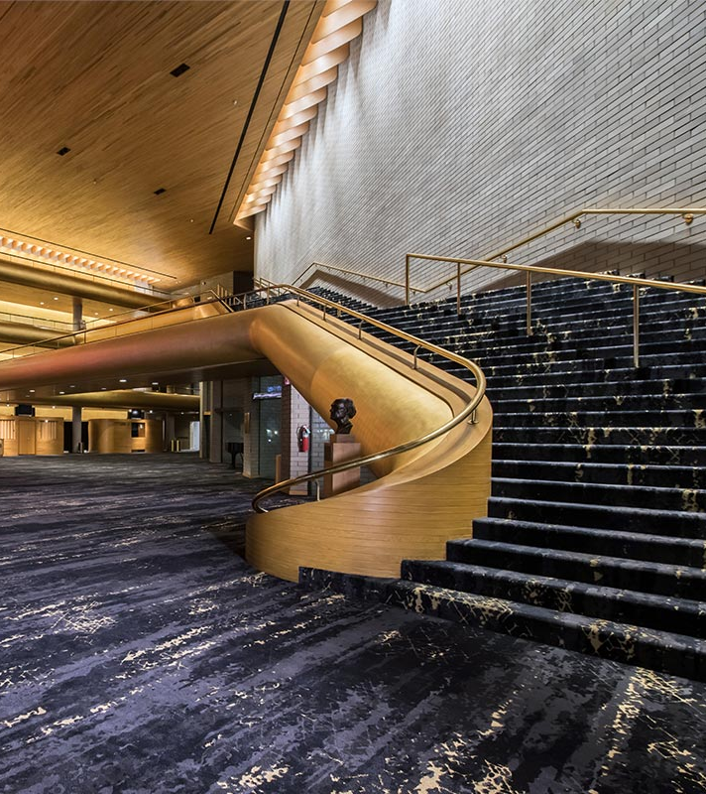
Before the Concert
In the Lobby
There are stairs that lead to three higher levels, known as ‘tiers.’
Ushers wearing black and white will show you where to sit.
You might sit on the ground level or you might go up to a tier. All of the seats have great views.

Slide 6
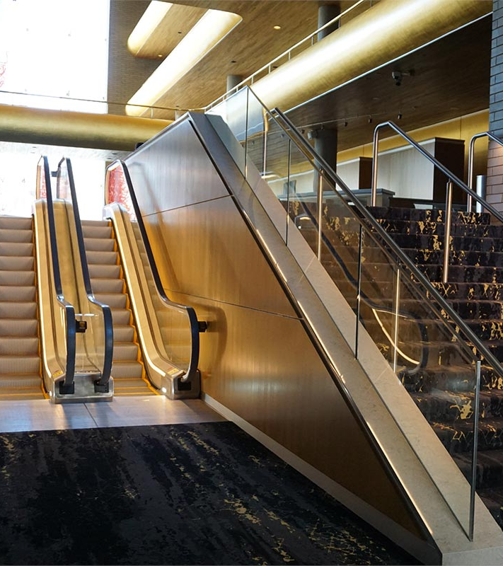
Before the Concert
Bathrooms are at the back of the building down the stairs.
There are also bathrooms on each tier.

Slide 7
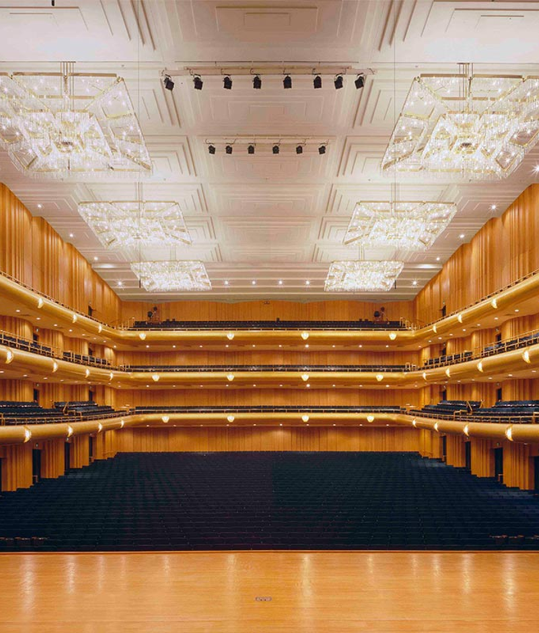
Before the Concert
Inside the hall
There are 2,766 seats.
There are 6 chandeliers, each with 3,000 crystals.
There is 12,000 square feet of gold leaf around the lobby and in the hall.

Slide 8
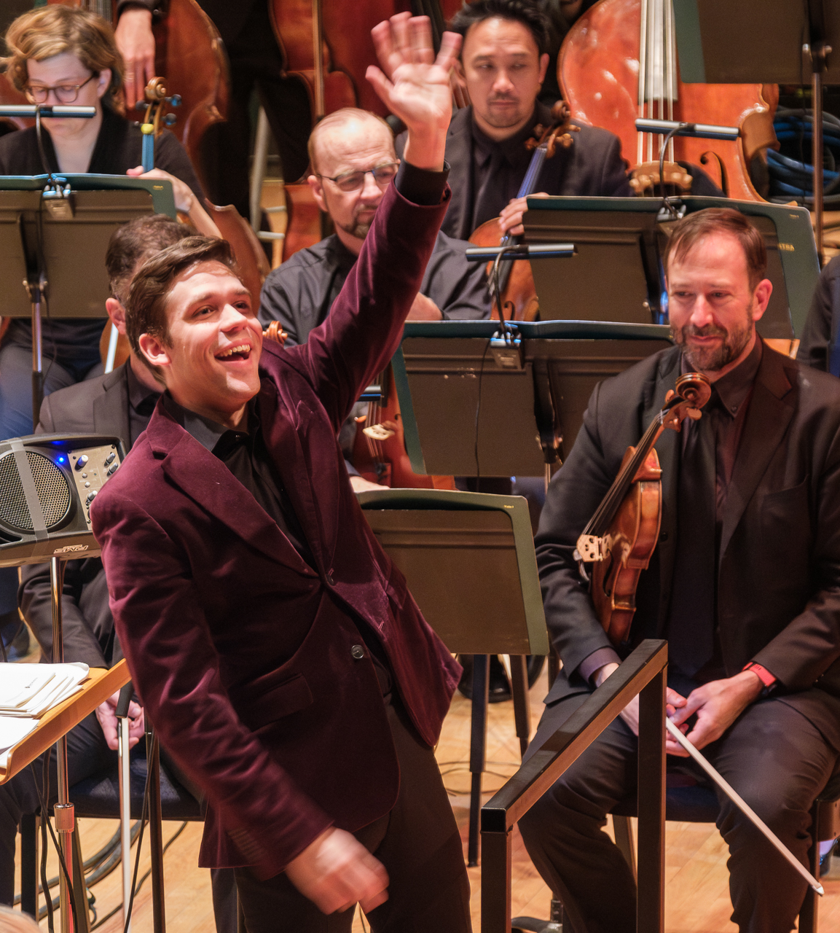
During the Concert
The concert is 50 minutes long.
You will hear 8 different pieces of music.
Between pieces, the hosts will talk to you about the music. They might invite you to participate, or to listen for something specific.
Matthew Straw (pictured) is the conductor for this concert.

Slide 9
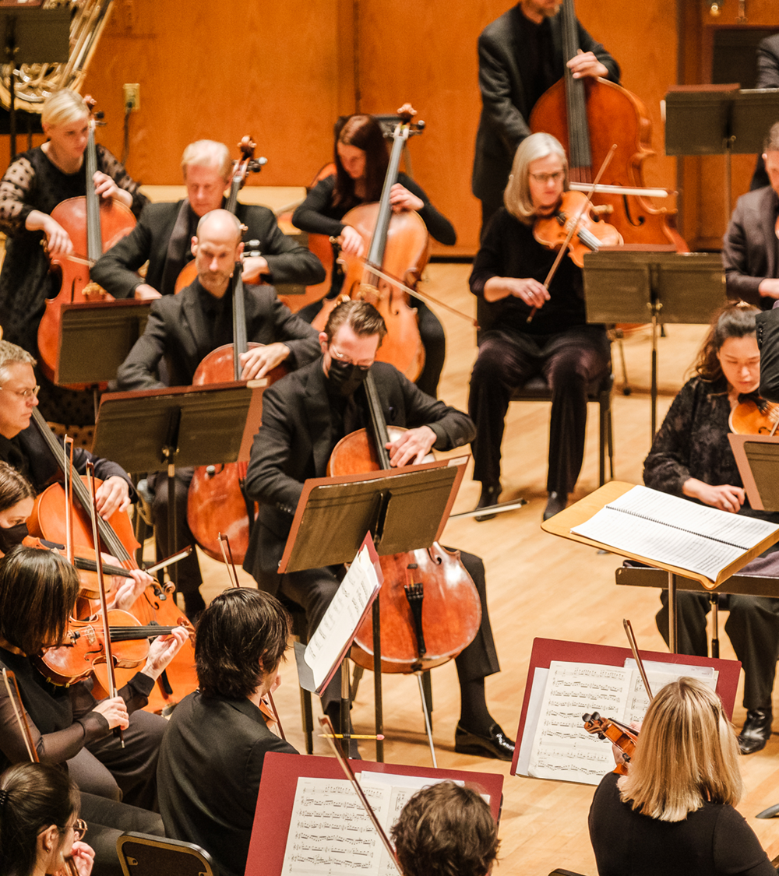
During the Concert
Be Respectful
Listen quietly and no not do anything that might distract those around you.
If you need to get up or ask your teacher something, try to wait for applause.
No food or candy in the hall.
Please silence cell phones. No recording.

Slide 10
During the Concert
When should I clap?
The audience will clap when the conductor enters and bows.
After each piece, watch the conductor. When they drop their hands, you may applaud.
Applauding is the best way to show the musicians how much you enjoyed the music.

Slide 11
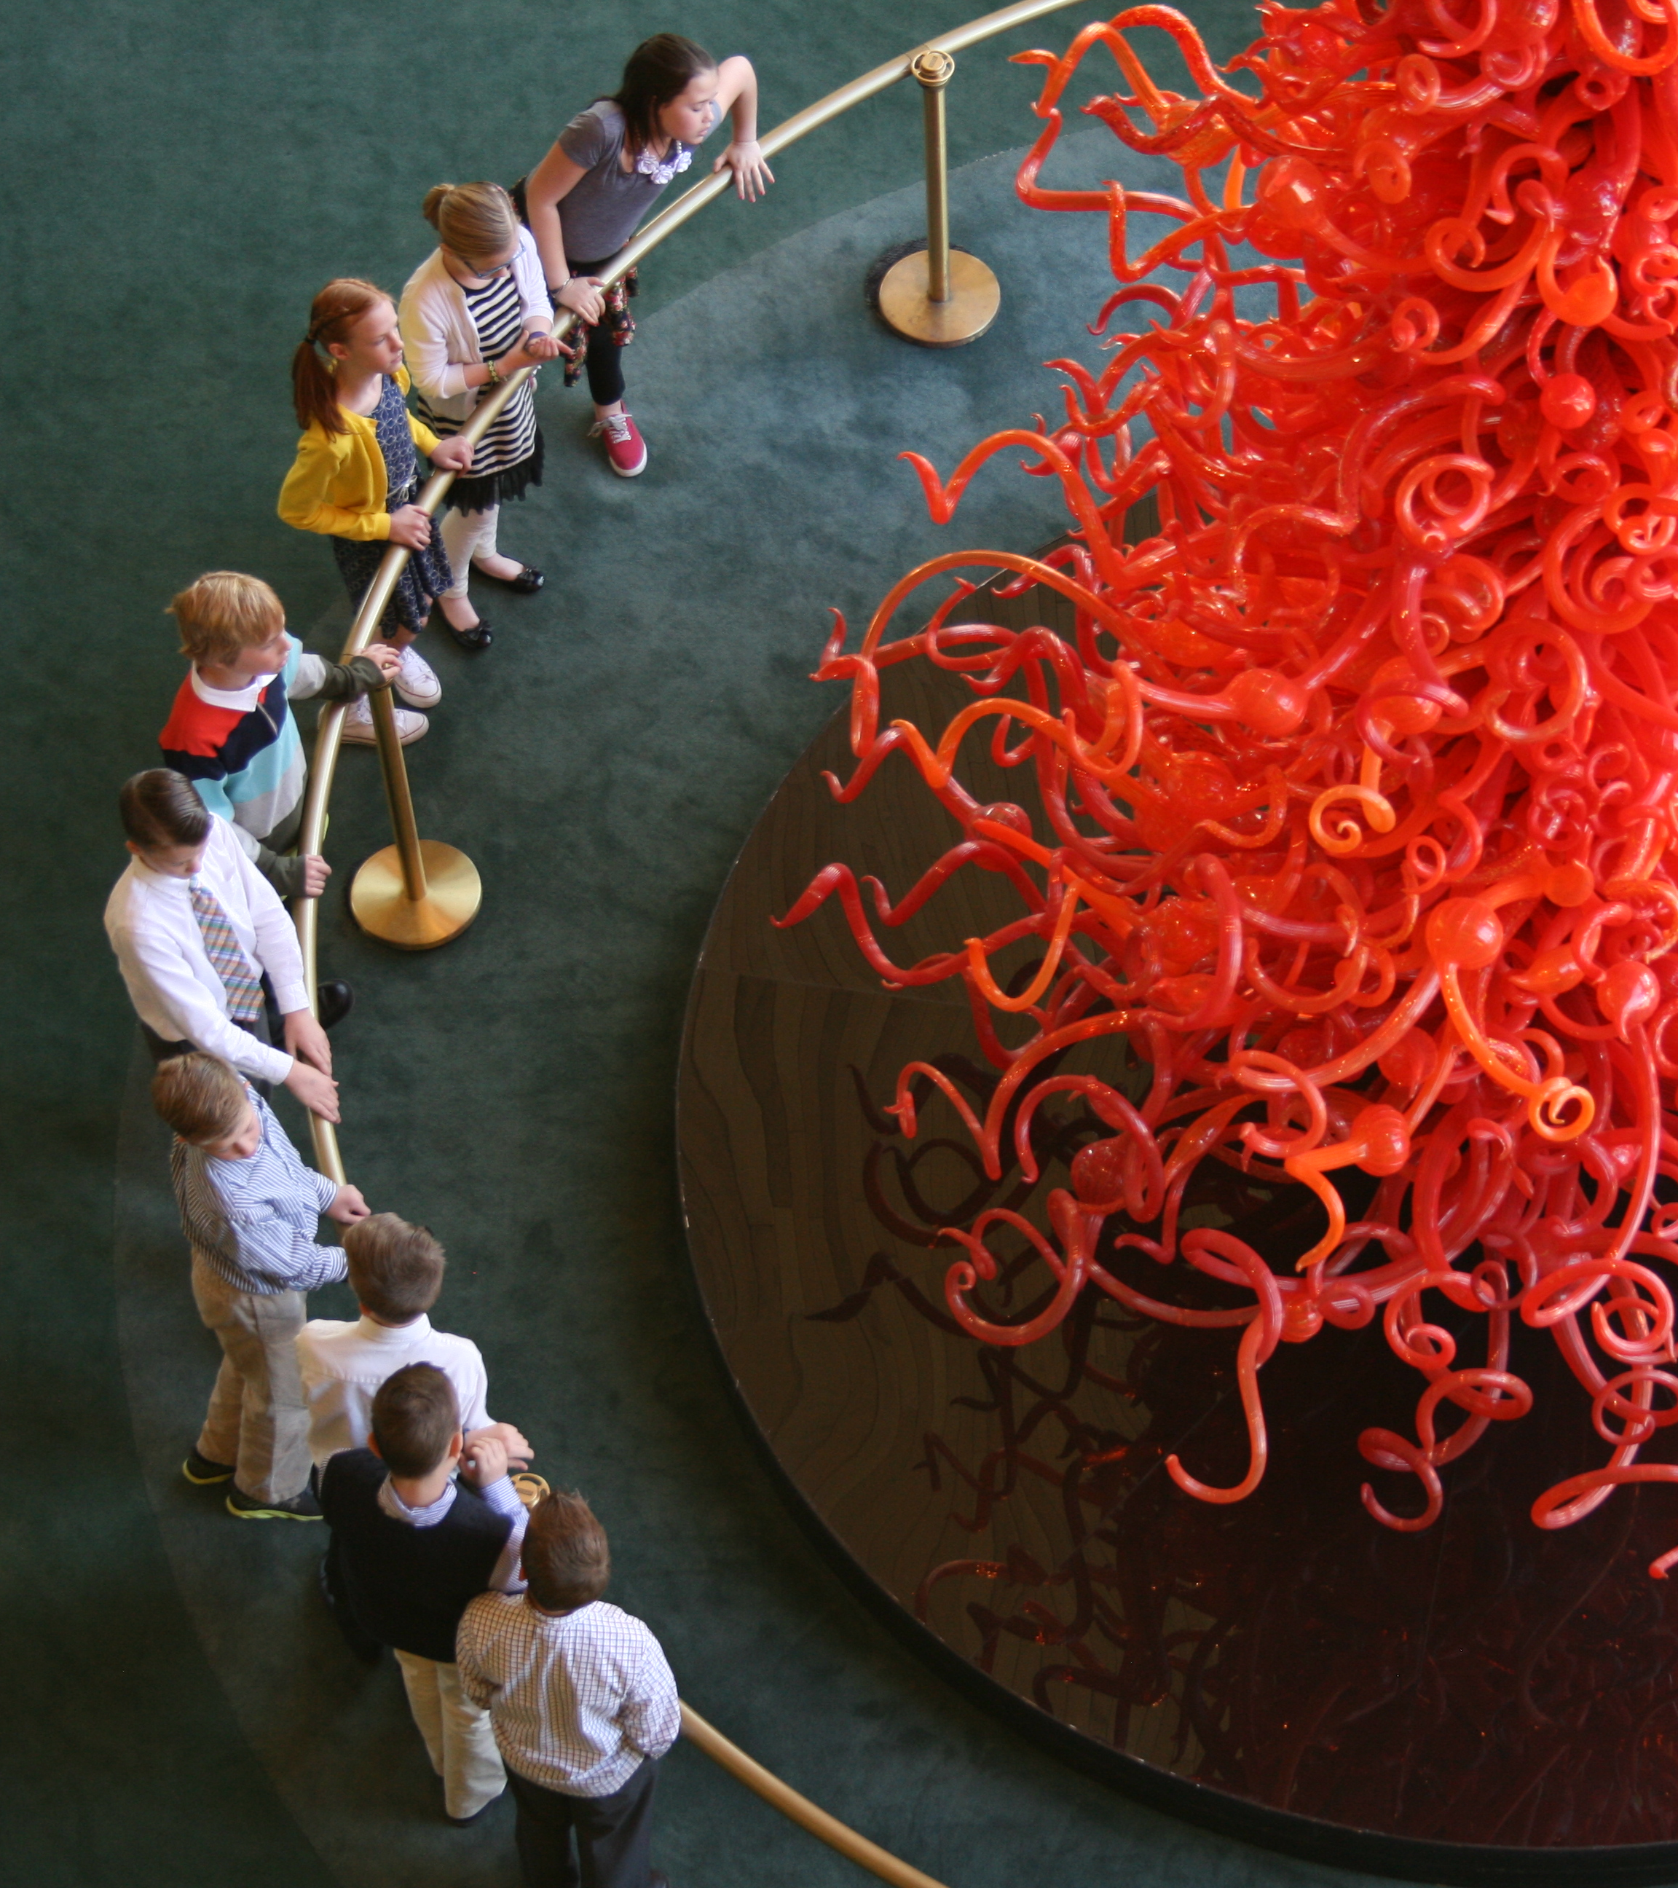
After the Concert
The ushers will help you exit the building. You will probably go out a different way than you came in.
If you have questions after the concert, you can email us or write us.
Utah Symphony Education
336 N 400 W
SLC, UT, 84103
usuoeducation@usuo.org

Slide 12
Thank you!
We hope you enjoy the concert!

