Slide 1
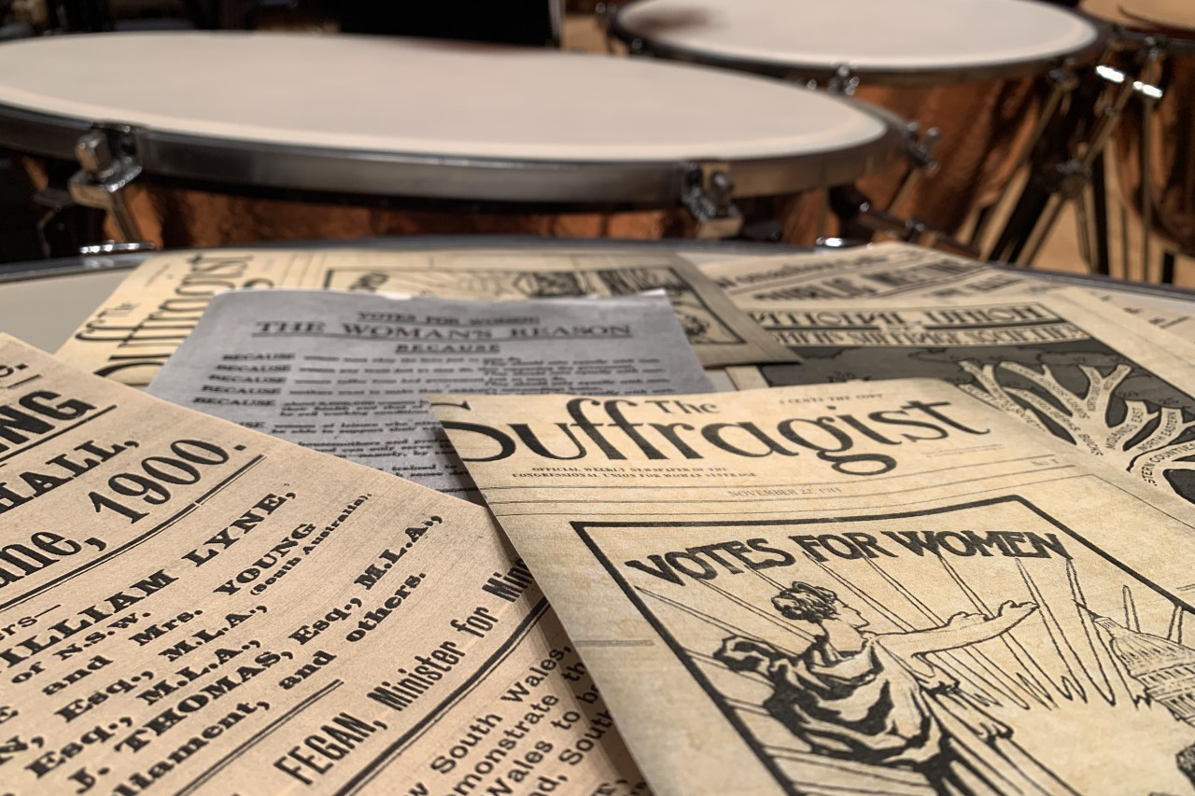
March
of the
Women
Notes:
Welcome to the Concert Preparation Presentation for Utah Symphony’s digital concert titled March of the Women. In this concert, we will explore the history of the 19th amendment to the United States Constitution and women’s accomplishments in the field of classical music. In this presentation, though, we will be using pieces from our concert to explore the basic elements of music.

Slide 2
The Elements
Timbre
Melody
Harmony
Rhythm
Tempo
Dynamics
Notes:
Every piece of music is made up of certain building blocks or elements. Learning about the elements can help us to listen to music more thoughtfully and purposefully. These are the elements we will learn about today: [CLICK] Rhythm {CLICK] Tempo [CLICK] Dynamics {CLICK] Melody {CLICK] Harmony [CLICK] and Timbre.
Every piece of music has all of thse elements, but we will use the pieces from our program to talk about one element at a time.

Slide 3
Timbre
Timbre (TAM-ber) – an instrument's unique voice or sound that makes it different from another instrument.
Let's play with Timbre!
Notes:
The first element we will discuss is Timbre.
Instruments are like people. They each have unique voices or TIMBRES. When you close your eyes, can you tell the difference between your teacher’s voice and your best friend’s voice?... Of course, you can! That is because your teacher and your friend have different voices; they have different timbres.
Even when they are playing the same notes, we can tell the difference between the violin and a trumpet, for instance, because they also have unique voices or timbres.
Timbre is an instrument’s unique voice that makes it different from another instrument. Let’s play with Timbre!

Slide 4
Joan Tower Fanfare for the Uncommon Woman
MUSIC DETECTIVES
Timbres of the Trumpet and the Timpani:
The Trumpet
The Timpani
This Photo by Unknown Author is licensed under CC BY-SA
Notes:
The piece you just heard is called Fanfare for the Uncommon Woman by the American Composer Joan Tower. [CLICK]
Let’s become Music Detectives and learn to identify two different instruments that you heard in the previous excerpt by their timbres.
First is the Trumpet. The trumpet is an instrument that is made from a metal called brass. Listen to its timbre as it plays a scale. [CLICK] As we listen to the first excerpt again, raise your hand when you hear the trumpets enter. [CLICK to Start] [CLICK when trumpets enter]
Next, let’s learn the timbre of the Timpani. The timpani are big copper-colored drums that can play specific pitches or notes. Listen first to their timbre.[CLICK] This next excerpt is from a bit later in the piece. The timpani player almost has a solo moment. As we listen to this excerpt, raise your hand when you hear the timpani loud and clear [CLICK to play] [CLICK when Timpani enters]

Slide 5
Melody & Harmony
Listen
cv
cv
cv
Sing
cv
cv
cv
cv
cv
Melody: the part of the song that gets stuck in your head
Melody:
Harmony: two (or more) notes that happen at the same time;
it supports the melody.
Harmony:
Notes:
Next we’ll learn about Melody and Harmony using a piece you already know. Listen to “Twinkle, Twinkle, Little Star.” [CLICK] Now let’s sing what you just heard [Give Seconds]. You probably sang the Melody. A simple way of explaining melody is the part of the song that gets stuck in your head. Here’s just the melody alone [CLICK]. Now, in the first recording there was also Harmony. Harmony is when two notes happen at the same time. Harmony also supports the melody. Let’s listen to just the Harmony alone. [CLICK]

Slide 6
Ethel Smyth March of the Women
MISSING MUSIC
Recording 1
Recording 2
The Melody is missing!
Is the Melody missing?
Is the Melody missing?
The Harmony is missing!
Is the Harmony missing?
Is the Harmony missing?
Notes:
CLICK to Play] The music you just heard is an excerpt from March of the Women by Ethel Smyth. Let’s listen to that excerpt one more time. See if you get any ideas about melody and harmony. Is there music that stands out to you that you could potentially sing? That would be the melody. Is there music that falls into the background or that is not easily sung? That would be the harmony. [CLICK to Play] [CLICK]
Let’s play around with Melody and Harmony. Listen carefully to identify what music is missing. We’re going to listen to two computer-created recordings of the same excerpt. In each recording either the melody or the harmony is missing. As you listen, see if you can identify what is missing. The answers will appear after both recordings play. [CLICK to Play Recording 1] [CLICK to Play Recording 2] Let’s see if you got it right. Here are the answers! [CLICK]

Slide 7
Rhythm
RHYTHM: how notes are placed around the beat.
BEAT: the steady heartBEAT
Clicking noise = beat. A scale is a group of notes that go down or up by one step at a time.
Scale + RHYTHM = What song is it?
Recording 1
Recording 2
Notes:
Rhythm is how notes are organized around the beat. It’s kind of like the pattern of the notes. [CLICK]
Beat is the steady pulse in the music like a heartbeat.
When we add rhythm to a group of notes, they suddenly become songs that we recognize. Let’s listen to this next recording of a set of notes that steadily go down one step at a time in what we call a scale. The clicking you hear is the beat [CLICK]
Now we’re going to add in our rhythm to our scale. See if you recognize what song it is! [CLICK]

Slide 8
Andrea Venet Omnes Trio
RHYTHM CLOSE - UP
1. Find the Beat
2. Clap the Rhythm
Notes:
This excerpt is from Dr. Andrea Venet’s Omnes Trio. Let’s take an even smaller excerpt of this music and see if we can identify the beat and learn one special rhythm. We’re going to zoom in on this section right at the beginning of this excerpt: [CLICK] First, let’s find the beat. [CLICK] Listen a few more times to find the heartbeat of the excerpt. A click will play the second and the third time to really help find the beat. [Click to play 1st time] [CLICK to play 2nd time] [CLICK to play 3rd time]
Now that we’ve found the beat, let’s learn a rhythm. The rhythm we’ll learn is created by the accents that the percussionists play. Accents in music are like exclamation points. Notes played with accents really stand out from the rest of the music.
You’ve heard this rhythm several times, now, so Learning it will probably be simple for you. Listen to the rhythm once. First, you will hear four tinkling sounds to get us ready, then the rhythm. [CLICK] Now listen again, but this time clap with the rhythm that begins after the tinkling sounds. [CLICK] Good job! Let’s zoom back out and listen to our big excerpt one more time. Try to tap along with the beat or clap the rhythm if you can!

Slide 9
Tempo
Tempo: speed of the music
Lento
Slow like a Snail
Andante
Walking Pace
Presto
Fast like a Cheetah
*There are many more tempo names; three were chosen for simplicity.
Notes:
Our next element of music is Tempo. The Tempo is how fast or slow the music is. In music, Tempo often gets Italian names. Let’s learn some Italian!
>CLICK<
The first is Lento. Lento means slow.
>CLICK<
Next is Andante (on-DON-tay). Andante comes from the word meaning, “to go,” so most people think of it as a walking pace– not too fast and not too slow.
>CLICK<
Lastly, we have Presto. Presto means quickly.

Slide 10
Tempo Test
Lento = Slow
Andante = Medium
Presto = Fast
Lento = Slow
Andante = Medium
Presto = Fast
Example #1
Example #2
Example #3
?
?
!
?
Lento
Lento
Lento
Andante
Andante
?
Andante
?
!
?
?
Presto
Presto
?
Presto
!
?
Notes:
We’re going to listen to three examples of pieces from the concert. Your job is to listen carefully to decide which example is Lento, which one is Andante, and which one is Presto. First we’ll listen to all three. After all three have played, the answers will be revealed [CLICK to play 1] [CLICK to play 2] Do you think that example 2 faster or slower than example 1? Now Example 3. [CLICK to play 3] Let’s see if you guessed them all correctly. Example 1 was … [CLICK] Andante! Example 2 was …. [CLICK] Lento! Example 3 was… [CLICK] Presto! Good job identifying tempo

Slide 11
Dynamics
Dynamics: volume of the music
pp
pianissimo
p
piano
mp
mezzo piano
mf
mezzo forte
f
forte
ff
fortissimo
Whisper
A little quieter than speaking volume
Speaking
volume
A little louder than speaking volume (like talking in a crowded room)
Yelling
Notes:
Dynamics is how loud or soft the music is; it’s the volume. [CLICK] Just like our tempo names, dynamic names are also in Italian. From left to right or from red to purple, here are the names. Try to say them reading along with me. And! To be extra clever, let’s say them at their dynamic level, so we’ll start by whispering the red dynamic. [whisper] Pianissimo [lightly say] Piano [Normal voice] Mezzo Piano… Mezzo Forte [raised voice] Forte [shout] Fortissimo.

Slide 12
Florence Price Suite of Dances
DYNAMIC DANCING
pp
pianissimo
p
piano
mp
mezzo piano
mf
mezzo forte
f
forte
ff
fortissimo
Whisper
A little quieter than speaking volume
Speaking volume
A little louder than speaking volume (like talking in a crowded room)
Yelling
Notes:
This next piece is the Suite of Dances by Florence Price. Our excerpt will start out softly and then grow to be loud. If it is safe to do so, stand up directly behind your chairs or wherever you’re sitting. Then, crouch down low to the ground. As the music grows in its dynamics or grows to be louder, grow your body with it. By the time you think the music is at its loudest point, you should be on your tiptoes with your hands stretching to the ceiling. Watch the screen for hints on how your body should look! [CLICK to Play] [CLICK to animate little guy up and down]

Slide 13
Certificate of Completion
Presented To:
You!
For successfully completing the Utah Symphony’s Concert Preparation Presentation and in doing so becoming MUSIC MASTERS by learning timbre, melody, harmony, rhythm, tempo, and dynamics.
Notes:
Congratulations! You’re ready to watch our concert and to listen more thoughtfully and carefully. We hope you enjoy the concert. On the next few slides, you will find the stage plot for each piece.

Slide 14
Stage Set-up for Piece #1:
Overture to L’Amant Anonyme, Mvt. III by Joseph Bologne Chevalier de Saint-Georges
Oboes
Horns
Basses
2nd Violins
Cellos
1st Violins
The
Violas
Conductor

Slide 15
Stage Set-up for Piece #2:
Chamber Symphony, Op. 110a, Mvt. II
by Dmitri Shostakovich
Basses
2nd Violins
Cellos
1st Violins
The
Violas
Conductor

Slide 16
Stage Set-up for Piece #3:
Umoja
by Valerie Coleman
Horn
Oboe
Bassoon
Flute
Clarinet
There will only be five players on stage for this amazing piece! Due to legal agreements, we could not include our audio recording of this piece, but you can listen here: https://www.youtube.com/watch?v=23Yx9gWHh0E

Slide 17
Stage Set-up for Piece #4:
Sospiri
by Edward Elgar
Harp
Basses
Keyboard
2nd Violins
Cellos
1st Violins
The
Violas
Conductor

Slide 18
Stage Set-up for Piece #5:
Fanfare for the Common Man
by Aaron Copland
Horns
Trombones
Percussion
Trumpets
Tuba
Bass Drum Tam-Tam
Timpani
The
Conductor

Slide 19
You can listen to all of the music that will be played at the concert by downloading our “Elementary Full Orchestra Concert Music” presentation
Go on an Adventure … during the concert!
Listening to music is a great opportunity to use your imagination!
How does it make you feel?
Can you imagine a great story to go with the music?
What movie scene might the music go with?
What landscape do you imagine?

Slide 20
Thanks to our Sponsors!
We look forward to having you watch this concert, made possible by the financial support of many donors, including generous funding from the Professional Outreach Programs in the Schools, appropriated by the Utah State Legislature with the Utah State Board of Education as well as the Elizabeth Brown Dee Fund for Music in the Schools and the Utah Education Network.
THE ELIZABETH BROWN DEE FUND FOR MUSIC IN THE SCHOOLS

